Slide 1


Sibyl: Adaptive and Extensible Data Placement in Hybrid Storage Systems
Using Online Reinforcement Learning
Gagandeep Singh, Rakesh Nadig, Jisung Park,
Rahul Bera, Nastaran Hajinazar, David Novo,
Juan Gómez Luna, Sander Stuijk, Henk Corporaal,
Onur Mutlu
Notes:
Hi First of all. Thank you very much for staying until this long.
I’m going to present our work “…”

Slide 2
Executive Summary
Background: A hybrid storage system (HSS) uses multiple different storage devices to provide high and scalable storage capacity at high performance
Problem: Two key shortcomings of prior data placement policies:
Lack of adaptivity to:
Workload changes
Changes in device types and configurations
Lack of extensibility to more devices
Goal: Design a data placement technique that provides:
Adaptivity, by continuously learning and adapting to the application and underlying device characteristics
Easy extensibility to incorporate a wide range of hybrid storage configurations
Contribution: Sibyl, the first reinforcement learning-based data placement technique in hybrid storage systems that:
Provides adaptivity to changing workload demands and underlying device characteristics
Can easily extend to any number of storage devices
Provides ease of design and implementation that requires only a small computation overhead
Key Results: Evaluate on real systems using a wide range of workloads
Sibyl improves performance by 21.6% compared to the best previous data placement technique in dual-HSS configuration
In a tri-HSS configuration, Sibyl outperforms the state-of-the-art-policy policy by 48.2%
Sibyl achieves 80% of the performance of an oracle policy with storage overhead of only 124.4 KiB
https://github.com/CMU-SAFARI/Sibyl
Notes:
First, I am going to start with an executive summary.
[CLICK] Hybrid storage systems use multiple different storage devices to provide high and scalable storage capacity at high performance
[CLICK] We observe two key shortcomings in prior data placement techniques:
First, lack of adaptivity to workload changes and changes in device types and configurations
Second, they also lack extensibility to to more devices.
[CLICK] Our goal in this work is to design a data placement technique that provides
Adaptivity, by continuously learning and adapting to the application and underlying device characteristics
Easy extensibility to incorporate a wide range of hybrid storage configurations
[CLICK] to this end we propose Sibyl, an online reinforcement learning-based data placement in Hybrid storage systems that:
Provides both adaptivity
and easy extensiblity
and also Provides ease of design and implementation that requires only a small computation overhead
[CLICK] We extensively evaluate Sibyl on real systems using a wide range of workloads
We show that Sibyl outperforms prior state-of-the-art data placement policeis by 21.6% in dual-hybrid storage system and upto 48.2% on trihybrid system
Sibyl achieves 80% of the performance of an oracle policy that has a complete knowledge of future access patterns while incurring a very modest storage overhead of only 124.4 KiB
The code will be opensourced on our GitHub repository.
https://github.com/CMU-SAFARI/Sibyl

Slide 3
Talk Outline
Key Shortcomings of Prior Data Placement Techniques
Formulating Data Placement as Reinforcement Learning
Sybil: Overview
Evaluation of Sybil and Key Results
Conclusion
Notes:
This is the outline of my talk.
First, I am going to start by discussing key shortcomings of prior data placement techniques.

Slide 4
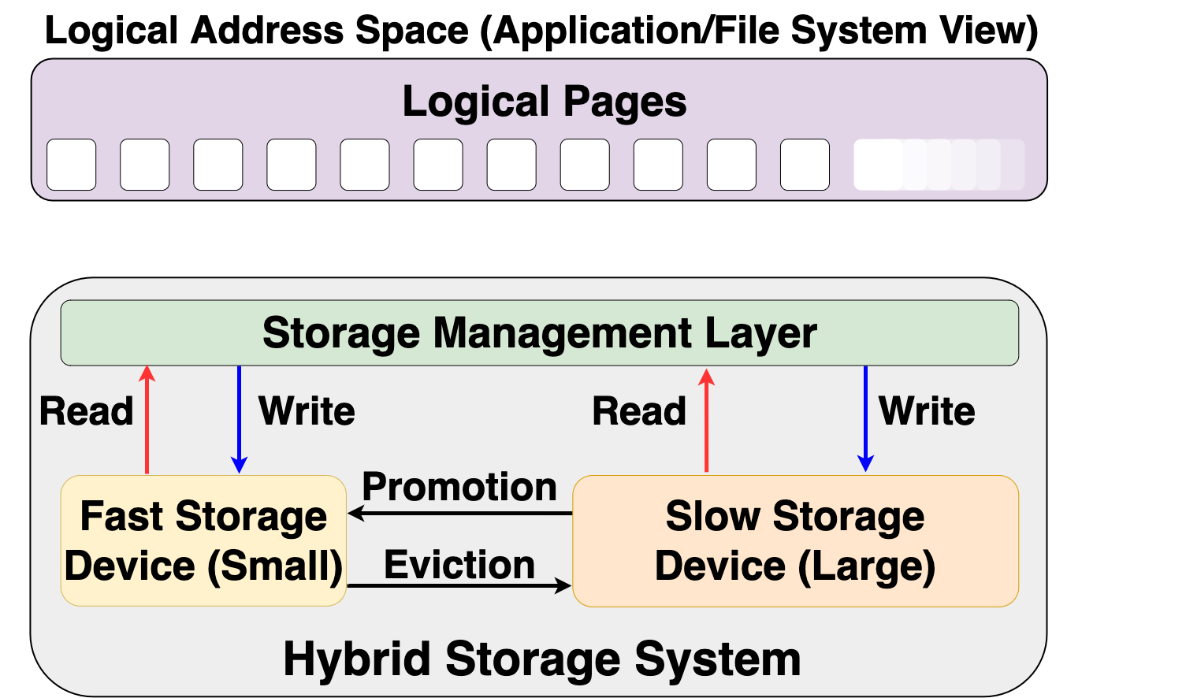


Hybrid Storage System Basics
Address Space (Application/File System View)
Read
Write
Storage Management Layer
Read
Write
Read
Write
Promotion
Eviction
Fast Device
Slow Device
Hybrid Storage System
Notes:
Let's look at some basics on hybrid storage systems. [CLICK] OVER here we show a typical HSS consisting of a fast-yet-small storage device and a slow-yet-large storage device
[CLICK]The address space is divided into a number of logical pages (e.g. 4kib), which are assigned to an application.
[CLICK] The storage management layer in the OS orchestrates host I/O requests across heterogeneous devices,
[CLICK] the storage management layer also manages data migration between the storage devices in an Hybrid storage systems . Eviction usually moves infrequently access data fom the fast storage to the slow storage or when the fast storage device is full.
When data currently stored in the slow storage device is moved to the fast storage device, it is called promotion. Promotion is usually performed when a page in the slow storage device is accessed frequently.
[CLICK] A desirable policy has to effectively utilize the low latency characteristics of the fast device while making optimal use of its small capacity and should provide easy extensibility to a wide range of workloads and Hybrid storage systems configurations

Slide 5
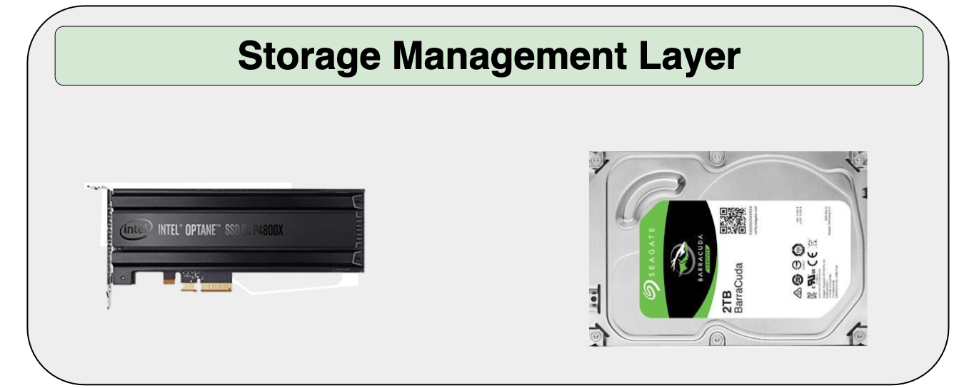
Hybrid Storage System Basics
Read
Write
Performance of a hybrid storage system
highly depends on the ability of the
storage management layer
Read
Write
Read
Write
Promotion
Eviction
Hybrid Storage System
Notes:
[CLICK] Therefore the performance of a hybrid storage system highly depends on the ability of the storage management layer to effectively manage diverse deviaces and workloads

Slide 6
Key Shortcomings in Prior Techniques
We observe two key shortcomings that significantly limit the performance benefits of prior techniques
Lack of adaptivity to:
Workload changes
Changes in device types and configuration
Lack of extensibility to more devices
Notes:
We observe two key shortcomings in prior data placement techniques that significantly limits their performance improvement
[CLICK] First, lack of adaptivity to both workload changes and
CLICK] changes in device types and configurations
[CLICK] Second, Lack of extensibility: to more devices
Let’s take a closer look at each of these shortcomings.
[NEXT]

Slide 7
Lack of Adaptivity
Workload Changes
Prior data placement techniques consider only a few workload characteristics that are statically tuned
CDE
RNN-HSS
Oracle
Notes:
First, Past techniques lack adaptivity to workload changes because
[CLICK] they only consider a limited number of workload characteristics
Designers statically tune the parameters values for all considered workloads at design time based on empirical analysis and designer experience, and expect those statically-fixed values to be equally effective for a wide range of dynamic workload demands
[CLICK] Over here we show average request latency OF 4 sample workloads, for CDE policy which is a state-of-the-art heurtisic based policy

Slide 8
Lack of Adaptivity
Workload Changes
Prior data placement techniques consider only a few workload characteristics that are statically tuned
CDE
RNN-HSS
Oracle
Notes:
and an RNN-HSS policy which is a supervised learning technique

Slide 9
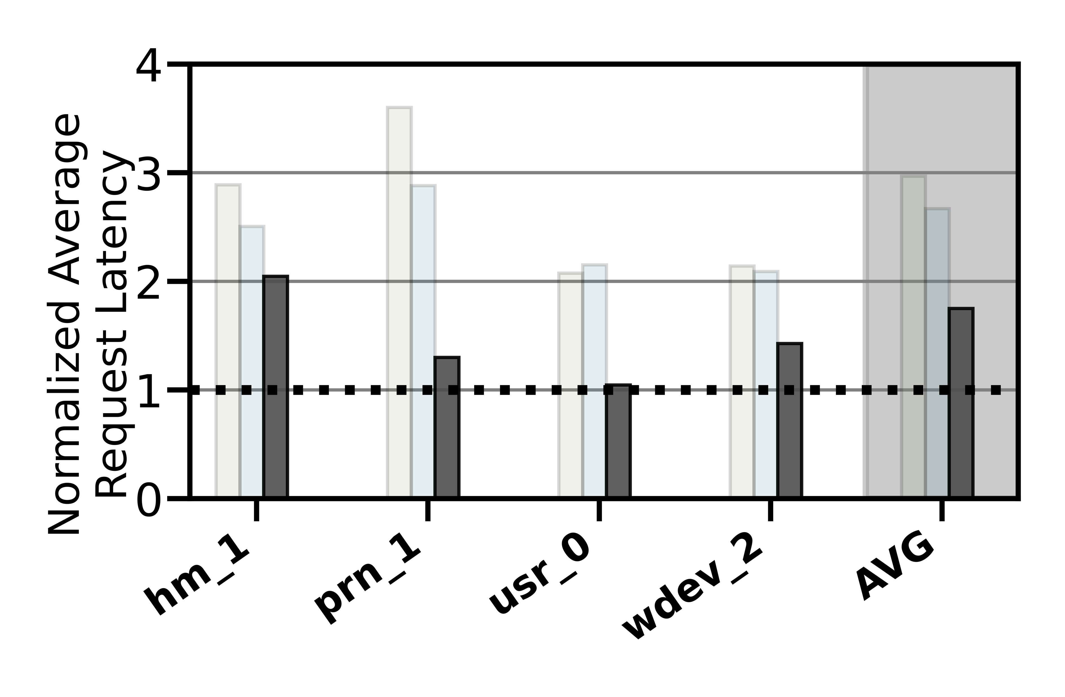
Lack of Adaptivity
Workload Changes
Prior data placement techniques consider only a few workload characteristics that are statically tuned
CDE
RNN-HSS
Oracle
Notes:
We compare these to an impractical Oracle: which has knowledge of future I/O access patterns.

Slide 10
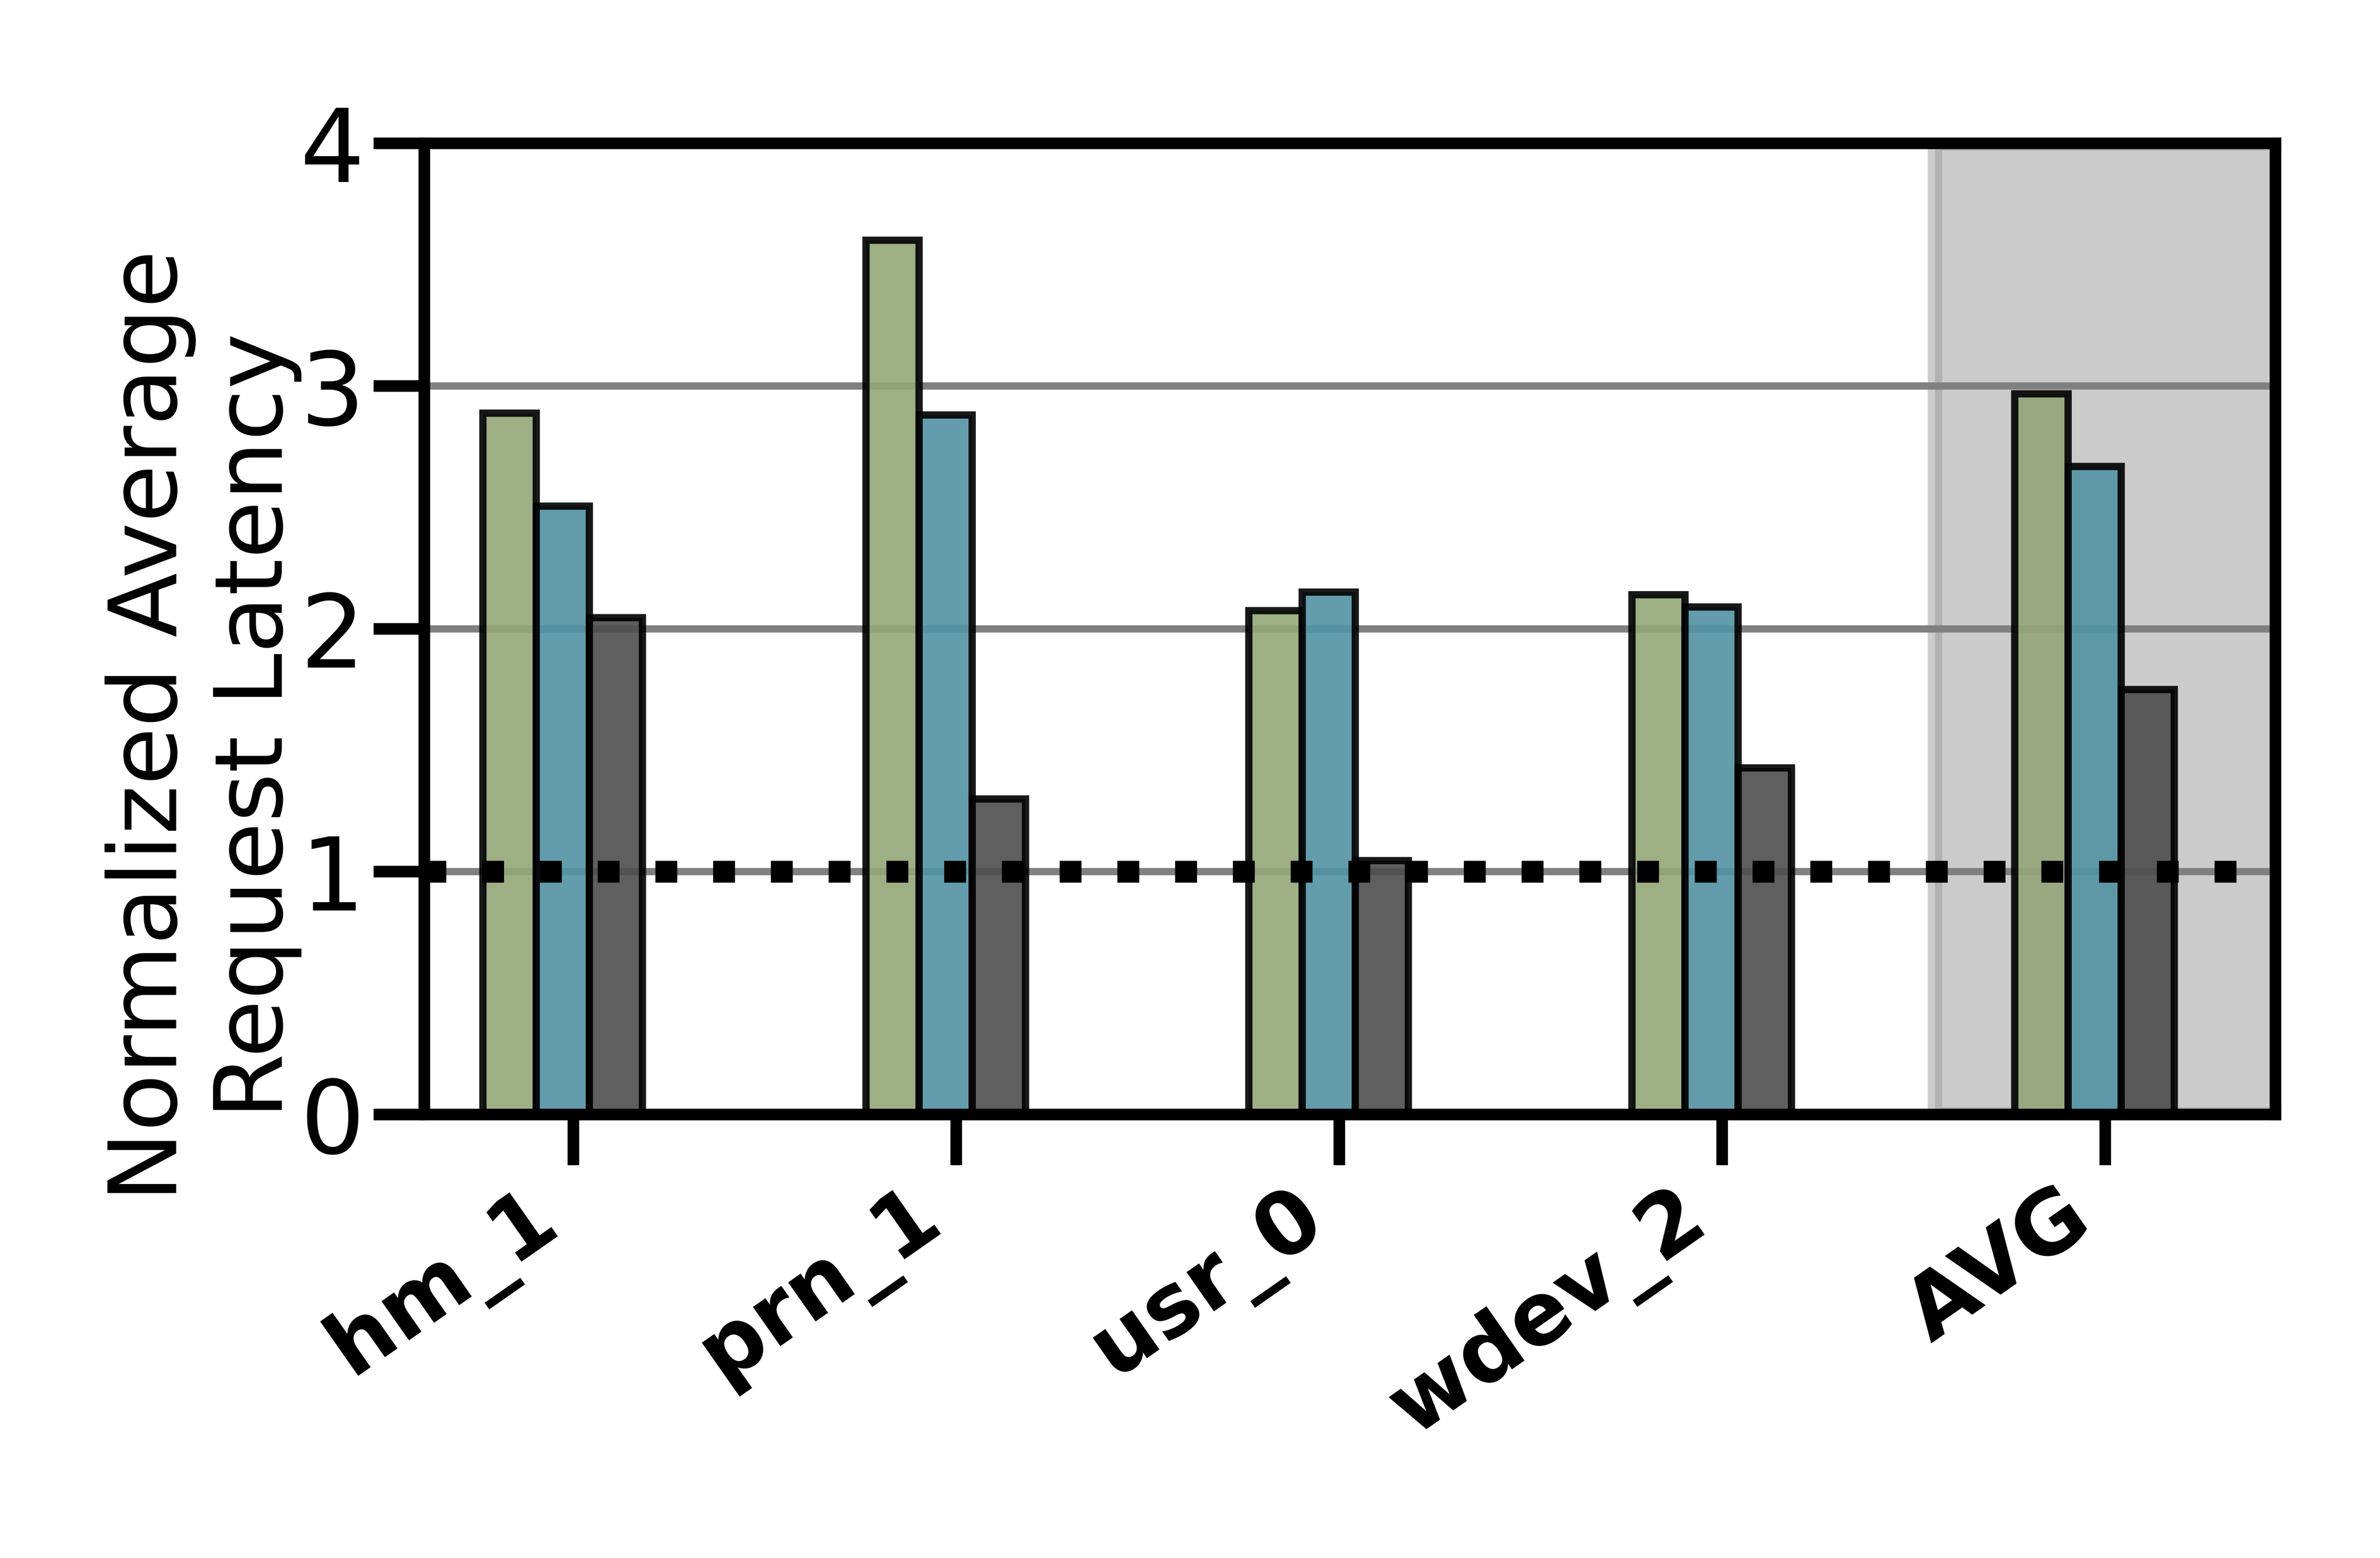
Lack of Adaptivity
Workload Changes
Prior data placement techniques consider only a few workload characteristics that are statically tuned
CDE
RNN-HSS
Oracle
41.1%
Notes:
The lower the request latency the better
We observe that all baselines provide reasonable performance under specific workloads [CLICK] while for other they show way lower performance than oracle. [CLICK]
[CLICK] on avg we observe a performance loss for some policies by 41.1% compared to oracle
We conclude, considering only a limited number of workload characteristics leads to
a significant performance gap

Slide 11
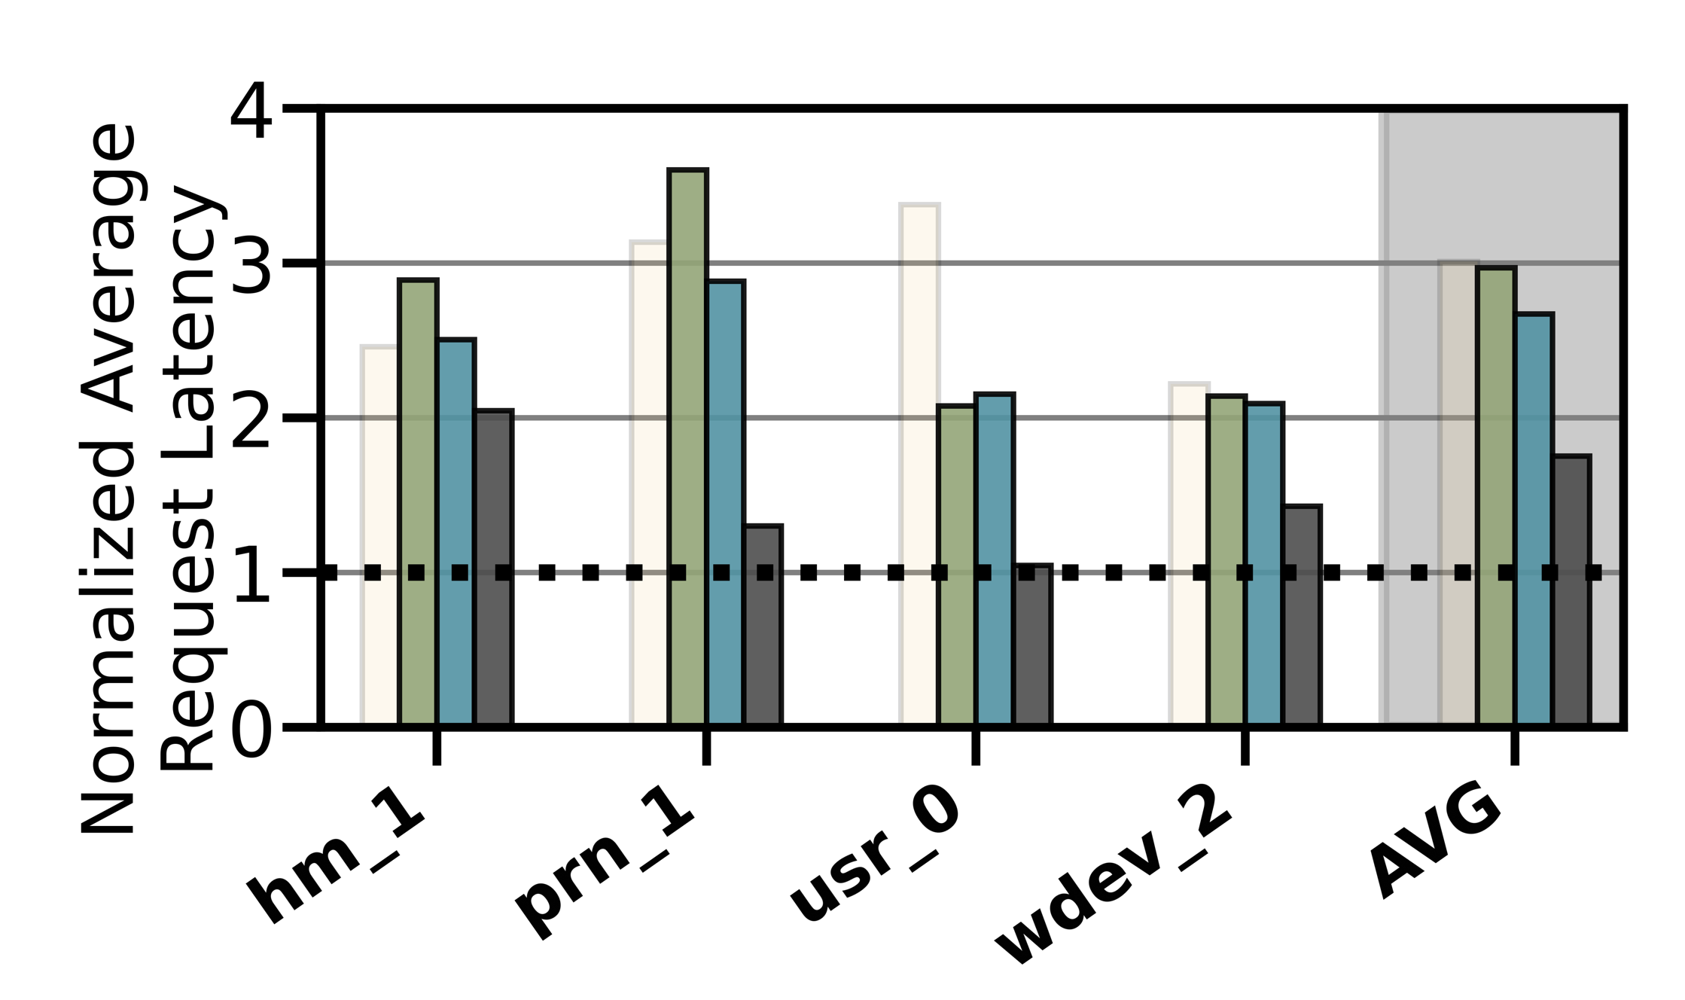
Lack of Adaptivity
Changes in Device Types and Configurations
Do not consider underlying storage device characteristics (e.g., changes in the level asymmetry in read/write latencies, garbage collection)
CDE
RNN-HSS
Oracle
HSS Configuration 1
Notes:
Also thsese techniques lack adaptivity to changes in device types and configurations because they
[CLICK] DO NOT CONSIDER underlying device CHARACTERISTICS. (e.g., changes in the level asymmetry in the read/write, garbage collection, …)
In this figure again we show the three policies and in addition, we have another

Slide 12
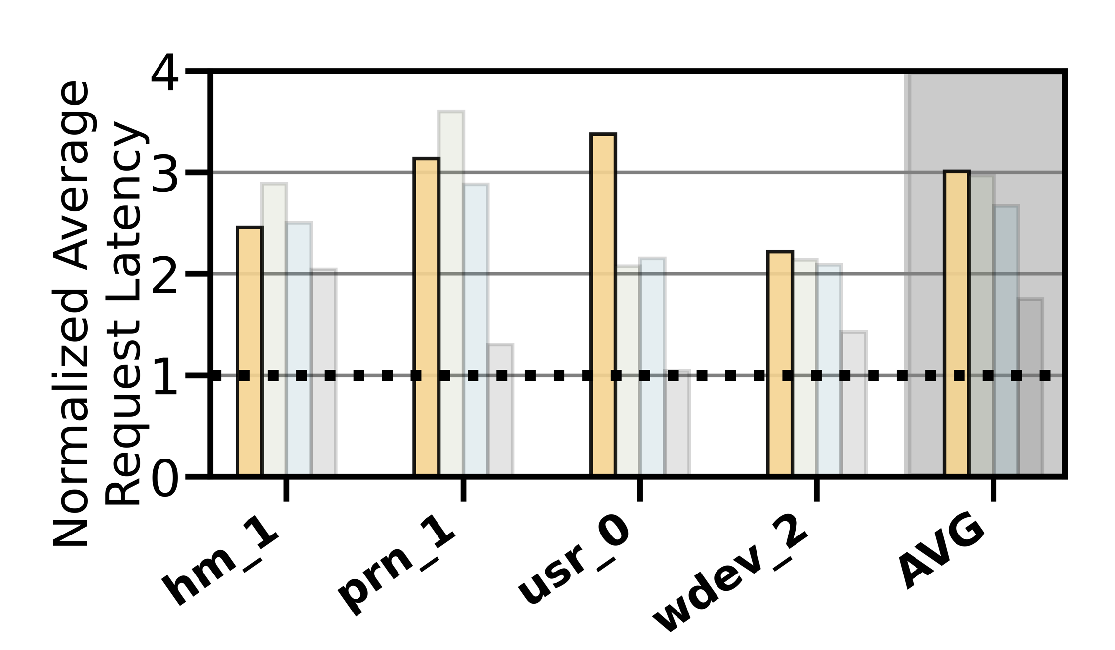
Lack of Adaptivity
Changes in Device Types and Configurations
Do not consider underlying storage device characteristics (e.g., changes in the level asymmetry in read/write latencies, garbage collection)
Slow-Only
CDE
RNN-HSS
Oracle
HSS Configuration 1
Notes:
extreme case when everything is placed in the slow storage

Slide 13
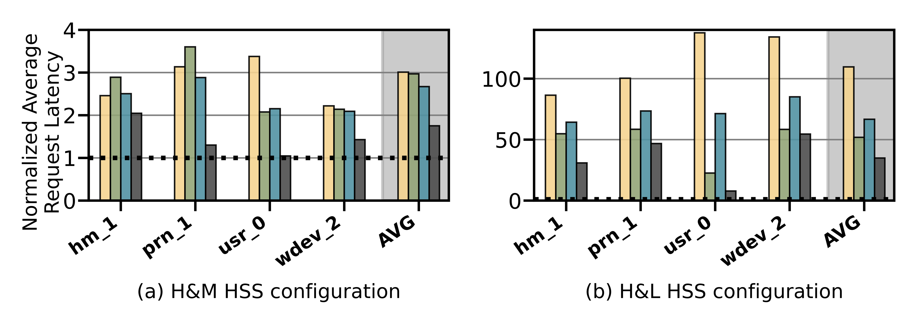
Lack of Adaptivity
Changes in Device Types and Configurations
Do not consider underlying storage device characteristics (e.g., changes in the level asymmetry in read/write latencies, garbage collection)
Slow-Only
CDE
RNN-HSS
Oracle
Slow-Only
CDE
RNN-HSS
Oracle
HSS Configuration 1
HSS Configuration 2
Notes:
We obseve that performance of some workloads is even worse than slow-only policy that places everything in the slow storage [CLICK] while in another hybrid storage configuration these workloads perform better than slow only[CLICK] [CLICK]
Therefore, we conclude that the high diversity in device characteristics makes it very difficult for a system architect to design a generic data-placement technique that is suitable for all Hybrid storage systems configurations

Slide 14


Lack of Extensibility
Rigid techniques that require significant effort to accommodate more than two devices
Change in storage configuration
Dual-HSS
Notes:
The second key shortcoming is that, most of the prior techniques are
[CLICK] rigid that require significant effort to accommodate more than two devices
if we extend from dual hybrid stroage configuration from dual hyrbid to a tri-hybrid configuration

Slide 15

Lack of Extensibility
Rigid techniques that require significant effort to accommodate more than two devices
Change in storage configuration
Design a new policy
Tri-HSS
Notes:
[click] design a new data policy to exploit the new device to eviction and promotino from the new storage and update heuristic values as wel. [CLICK]
Therefore system architects need to put significant effort into extending prior data placement techniques to accommodate more than two devices [CLICK] This wastes precious design time and human resource.

Slide 16
Our Goal
A data-placement mechanism
that can provide:
Adaptivity, by continuously learning and adapting to the application and underlying device characteristics
Easy extensibility to incorporate a wide range of hybrid storage configurations
Notes:
So our goal in this work is to design a data-placement mechanism that can provide
[CLICK]
Adaptivity, by continuously learning and adapting to the application and underlying device characteristics
[CLICK]
Easy extensibility to incorporate a wide range of hybrid storage configurations.

Slide 17

Our Proposal
Sibyl
Formulates data placement in hybrid storage systems as a reinforcement learning problem
Sybil is an oracle that makes accurate prophecies
https://en.wikipedia.org/wiki/Sibyl
Notes:
To this end, we propose Sibyl
Which formulates data placement in hybrid…

Slide 18
Talk Outline
Key Shortcomings of Prior Data Placement Techniques
Formulating Data Placement as Reinforcement Learning
Sybil: Overview
Evaluation of Sybil and Key Results
Conclusion
Notes:
Lets go into the formulation of dataplacement as a reinforcement learning problem

Slide 19
Basics of Reinforcement Learning (RL)
Agent learns to take an action in a given state
to maximize a numerical reward
Notes:
First, let me briefly describe the basics of reinforcement learning.
A RL system contains two components: [CLICK] the agent and the environment.
The agent observes the state of the environment in every timestep [CLICK], takes an action based on the state [CLICK], and receives a reward for that action [CLICK].
[CLICK] Agent’s goal is to find a policy where agent’s action in a given state leads to maximum reward

Slide 20
Formulating Data Placement as RL
Agent
State (S_{t})
Reward (R_{t+1})
Action (A_{t})
Environment
Sibyl
Features of the current request and system
Request latency
(of last served request)
Select storage device to place the current page
Hybrid Storage System
Notes:
In Sibyl, we formulate data-placement as a reinforcement learning problem.
[CLICK] Sibyl acts as the agent, while [CLICK] the hybrid storage subsystem acts as the environment.
[CLICK] Sibyl observes workload and system features from every storage request and use it as a state information to take a data placement action [CLICK]
[CLICK] For every data placement action, Sibyl receives a numerical reward that evaluates the effectiveness of the data placement decision
Now we will concretely define the state, action, and the reward for Sibyl.

Slide 21

What is State?
Sibyl
Features of the current request and system
Request latency
(of last served request)
Select storage device to place
the current page
Limited number of state features:
Reduce the implementation overhead
RL agent is more sensitive to reward
6-dimensional vector of state features
We quantize the state representation into bins to reduce storage overhead
Hybrid Storage System
Notes:
[CLICK] For the state, we use limited number of state features after performing feature selection to:
reduce implementation overhead
[CLICK] and we observe RL agent's perfromance is more sensitive to the reward than state features. So adding many feature does not help
[CLICK] We define the state as a 6-dimensional vector of program features.
[CLICK] Some examples are the size of the incoming request the type of request etc
[click] we also quantize the state representation into bins to reduce the storage overhead

Slide 22
What is Reward?
Sibyl
Features of the current request and system
Request latency
(of last served request)
Select storage device to place
the current page
Defines the objective of Sibyl
We formulate the reward as a function of the request latency
Encapsulates three key aspects:
Internal state of the device (e.g., read/write latencies, the latency of garbage collection, queuing delays, …)
Throughput
Evictions
More details in the paper
Hybrid Storage System
Notes:
The reward defines the objective of Sibyl
[CLICK] Though Sibyl can learn from any …, in this paper we formulate the reward as a function of the request latency
[CLICK] A reward encapsulates three metrics: …

Slide 23
What is Action?
Sibyl
Features of the current request and system
Request latency
(of last served request)
Select storage device to place
the current page
At every new page request, the action is to select a storage device
Action can be easily extended to any number of storage devices
Sibyl learns to proactively evict or promote a page
Hybrid Storage System
Notes:
We define the action as the selection of a storage device to place the current page.
[CLICK] Such an action allows easy extensiblity to any number of storage devices
[CLICK] it makes SIbyl learn to proactively evit or promote a page from the storage device

Slide 24
Talk Outline
Key Shortcomings of Prior Data Placement Techniques
Formulating Data Placement as Reinforcement Learning
Sybil: Overview
Evaluation of Sybil and Key Results
Conclusion
Notes:
We now provide a brief overview and design of Sibyl.

Slide 25
Sibyl Execution
RL Training Thread
Asynchronous
Execution
State, Reward, and Action Information
Periodic Policy
Weight Update
Storage
Request
(from OS)
RL Decision Thread
Data Placement Decision
Sibyl
Notes:
FIRST we discuss the execution model for Sibyl. We implement sibyl in the the host OS. [CLICK] Where for every storage request Sibyl uses an RL decision thread to make [CLICK] data placemnet decisions.
Sibyl uses another thread, [CLICK] called the RL training thread that works in the background. It keeps collecting information about Sibyl's state, action and reward, which uses this information to train a data placement policy. [CLICK] periodically we replace the RL decision thread policy with RL training thread policy.
[CLICK] Our two-threaded implementation runs ASYNCHROUNOUS AND avoids that the training in RL training thread interrupts or delays data placement decisions for incoming requests.

Slide 26
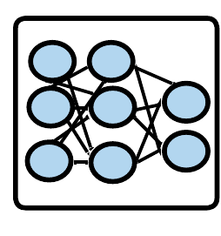
Sibyl Design: Overview
RL Training Thread
Training
Network
Training Dataset
Batch
Periodic Policy
Weight Update
Periodic Weights update
10
RL Decision Thread
Experience Buffer (in host DRAM)
State
Max
Action
Storage
Request
(from OS)
Inference
Network
Sibyl Policy
Observation
Vector
HSS
Reward
Collect
Experiences
State
Notes:
Now we will go into the implementation of each thread

Slide 27
RL Decision Thread
RL Training Thread
Training
Network
Training Dataset
Batch
Periodic Policy
Weight Update
RL Decision Thread
Experience Buffer (in host DRAM)
State
Max
Action
Storage
Request
(from OS)
Inference
Network
Sibyl Policy
Observation
Vector
HSS
Reward
Collect
Experiences
State
Notes:
First we discuss the RL decision thread, where Sibyl decides the data placement of the current storage request while collecting information about its decisions

Slide 28
RL Decision Thread
RL Training Thread
Training
Network
Training Dataset
Batch
Periodic Policy
Weight Update
RL Decision Thread
Experience Buffer (in host DRAM)
State
Max
Action
Storage
Request
(from OS)
Inference
Network
Sibyl Policy
Observation
Vector
HSS
Reward
Collect
Experiences
State
Notes:
For every new storage request to the Hybrid storage systems , Sibyl uses the state information to make a data placement action.

Slide 29
RL Decision Thread
RL Training Thread
Training
Network
Training Dataset
Batch
Periodic Policy
Weight Update
RL Decision Thread
Experience Buffer (in host DRAM)
State
Max
Action
Storage
Request
(from OS)
Inference
Network
Sibyl Policy
Observation
Vector
HSS
Reward
Collect
Experiences
State
Notes:
The inference network predicts the expected benefits of each action for a given state.
Sibyl policy selects the action with the highest expected benefit
or, a random action for exploration of the Hybrid storage systems

Slide 30
RL Decision Thread
RL Training Thread
Training
Network
Training Dataset
Batch
Periodic Policy
Weight Update
RL Decision Thread
Experience Buffer (in host DRAM)
State
Max
Action
Storage
Request
(from OS)
Inference
Network
Sibyl Policy
Observation
Vector
HSS
Reward
Collect
Experiences
State
Notes:
While making data placement decision, Sibyl collects information about the state, action, and reward

Slide 31
RL Decision Thread
RL Training Thread
Training
Network
Training Dataset
Batch
Periodic Policy
Weight Update
RL Decision Thread
Experience Buffer (in host DRAM)
State
Max
Action
Storage
Request
(from OS)
Inference
Network
Sibyl Policy
Observation
Vector
HSS
Reward
Collect
Experiences
State
Notes:
in an experience buffer, which in used in RL Training thread

Slide 32
RL Training Thread
RL Training Thread
Training
Network
Training Dataset
Batch
Periodic Policy
Weight Update
Periodic Weights update
10
RL Decision Thread
Experience Buffer (in host DRAM)
State
Max
Action
Storage
Request
(from OS)
Inference
Network
Sibyl Policy
Observation
Vector
HSS
Reward
Collect
Experiences
State
Notes:
In the RL training thread, Sibyl uses the collected experiences to update its decision making policy online by training a neural network.
Sibyl continuously learns from its past decisions and their impact.

Slide 33
Periodic Weight Transfer
RL Training Thread
Training
Network
Training Dataset
Batch
Periodic Policy
Weight Update
Periodic Weights update
10
RL Decision Thread
Experience Buffer (in host DRAM)
State
Max
Action
Storage
Request
(from OS)
Inference
Network
Sibyl Policy
Observation
Vector
HSS
Reward
Collect
Experiences
State
Notes:
To enable the parallel execution of the two threads, we duplicate the neural network that is used to make data placement decisions, so the inference network does not have a separate training steps and only uses the weights of the training network, which we periodically update.

Slide 34
Talk Outline
Key Shortcomings of Prior Data Placement Techniques
Formulating Data Placement as Reinforcement Learning
Sybil: Overview
Evaluation of Sybil and Key Results
Conclusion
Notes:
We now present our key results

Slide 35


Evaluation Methodology (1/3)
Real system with various HSS configurations
Dual-hybrid and tri-hybrid systems
AMD Ryzen7 2700G CPU
Intel Optane SSD P4800X
Seagate HDD
ST1000DM010
Intel SSD D3-S4510
ADATA
SU630 SSD
Notes:
[CLICK] We perfrom real system evaluation for both dual-hybrid and tri-hybrid systems
[CLICK] over here we show our evaluation setup that consists of multi different devices
[CLICK] We implement sibyl in the storage management layer of AMD Ryzen 7 2700G CPU

Slide 36
Evaluation Methodology (2/3)
Cost-Oriented HSS Configuration
High-end SSD
Low-end HDD
Performance-Oriented HSS Configuration
High-end SSD
Middle-end SSD
Notes:
First we evalutate a cost-oriented hybrid storage configuration in which we use
[CLICK]a high end ssd with a low-end hard disk drive where the latency difference between the two devices is quite large
[CLICK] Performance oriented hybrid storage configuration we
[CLICK]use a high end ssd with a middle end ssd
where two devices have similar latencies

Slide 37
Evaluation Methodology (3/3)
18 different workloads from:
MSR Cambridge and Filebench Suites
Four state-of-the-art data placement baselines:
CDE [Matsui+, Proc. IEEE’17]
HPS [Meswani+, HPCA’15]
Archivist [Ren+, ICCD’19]
RNN-HSS [Doudali+, HPDC’19]
Heuristic-based
Learning-based
Notes:
[CLICK] We use 18 different workloads from MSR CAMBRIDGE and Filebench Suite
[CLICK] and compare Sibyl against four state of heuristic and supervised—learning based data placmenet policies

Slide 38
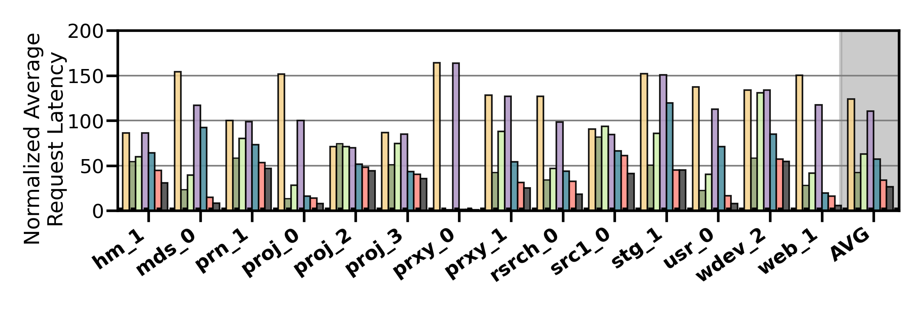
Performance Analysis
High-end SSD
Low-end HDD
Cost-Oriented HSS Configuration
Slow-Only
CDE
HPS
Archivist
RNN-HSS
Sibyl
Oracle
Notes:
[CLICK]Over here we show the performance results in terms of average request latency for MSR CAMBRIDGE workloads for all the workloads and policies

Slide 39
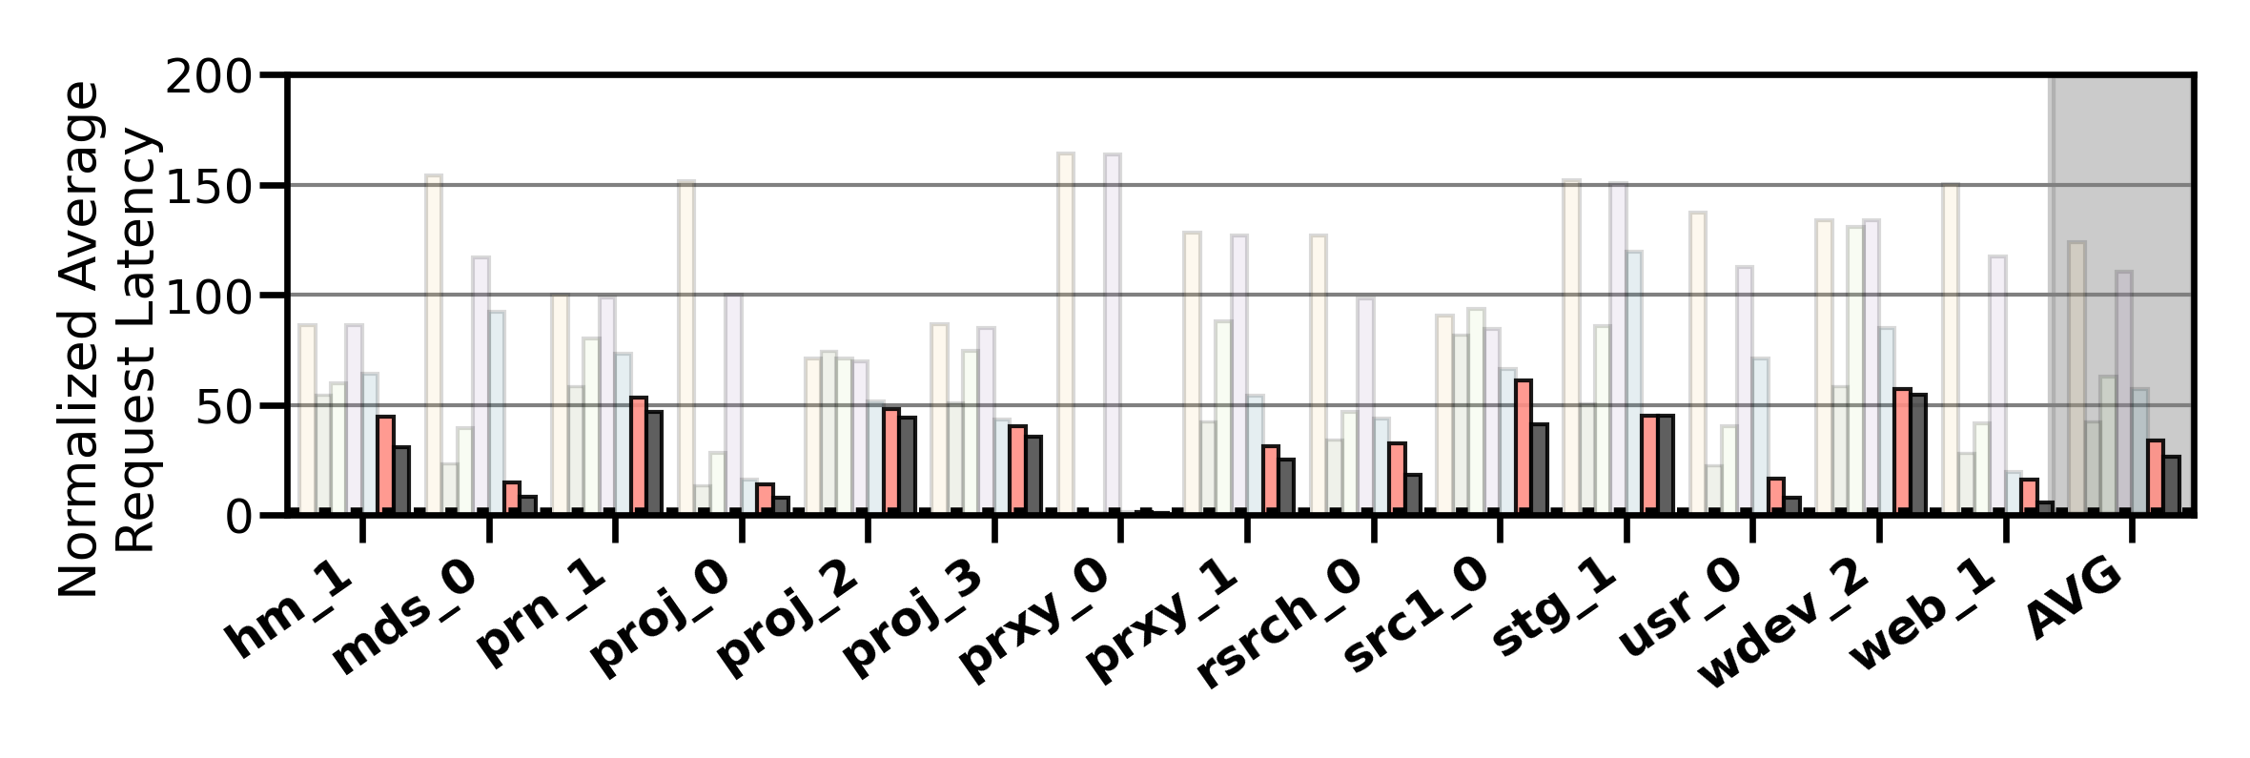
Performance Analysis
High-end SSD
Low-end HDD
Cost-Oriented HSS Configuration
Slow-Only
CDE
HPS
Archivist
RNN-HSS
Sibyl
Oracle
Sibyl consistently outperforms all the baselines
for all the workloads
Notes:
We observe that Sibyl consistently outperforms all the baselines for all the workloads

Slide 40
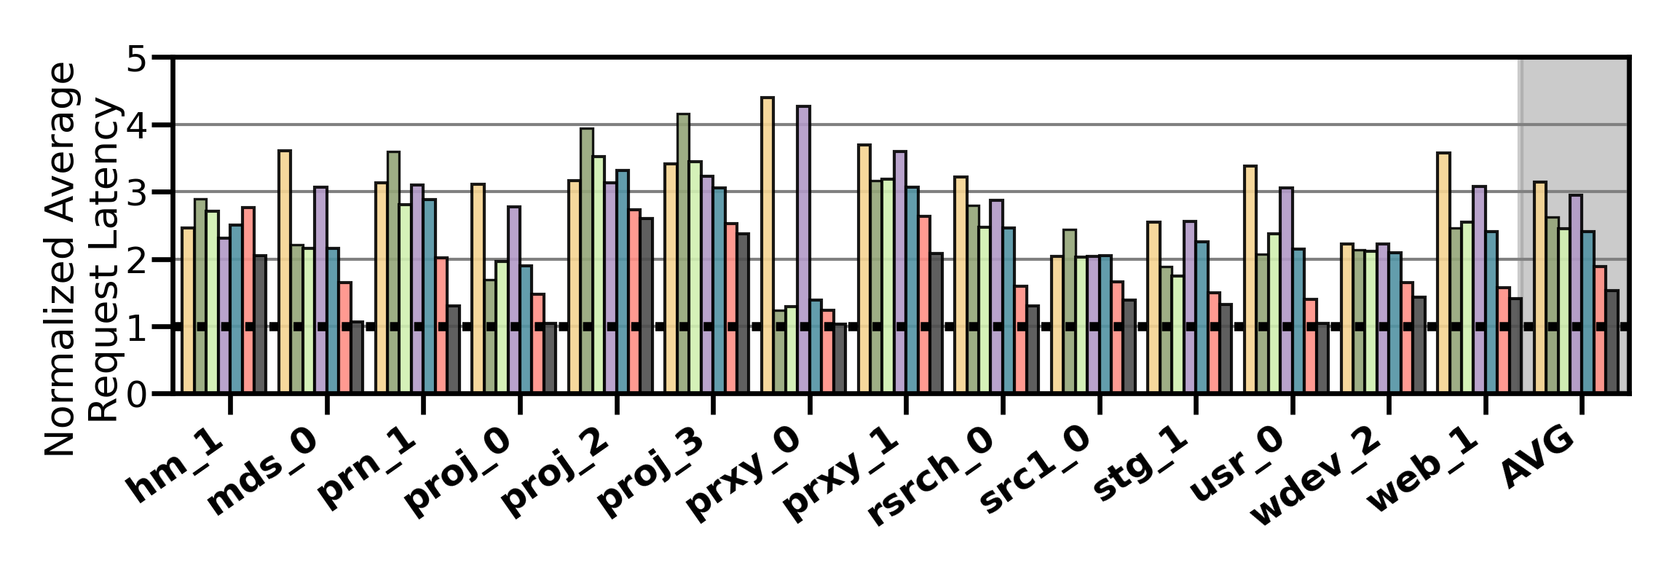
Performance Analysis
High-end SSD
Mid-end SSD
Performance-Oriented HSS Configuration
Slow-Only
CDE
HPS
Archivist
RNN-HSS
Sibyl
Oracle
Notes:
In a performance oriented Hybrid storage systems configuration, where two devices have similar latencies [CLICK]
[CLICK]

Slide 41
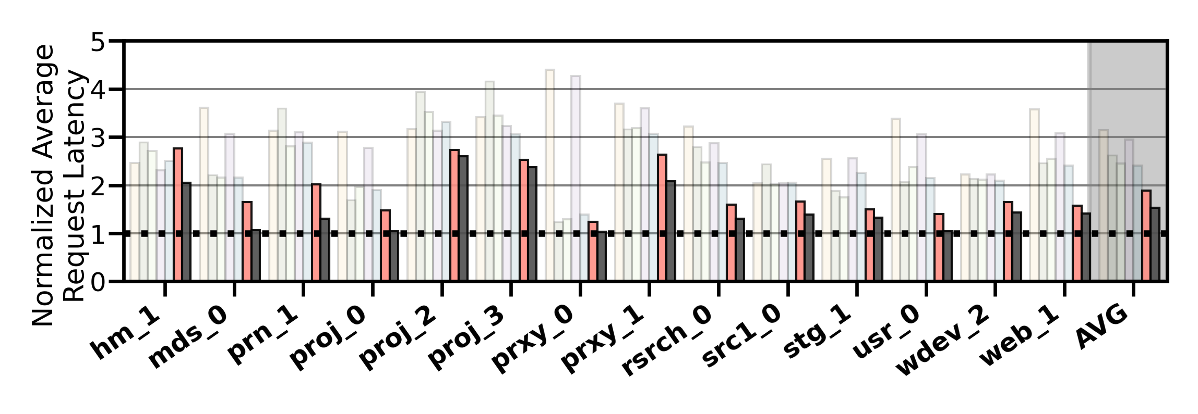
Performance Analysis
High-end SSD
Mid-end SSD
Performance-Oriented HSS Configuration
Slow-Only
CDE
HPS
Archivist
RNN-HSS
Sibyl
Oracle
Sibyl provides 21.6% performance improvement by dynamically adapting its data placement policy
Notes:
Sibyl provides 21.6% performance improvement by dynamically adapting its data placement policy

Slide 42
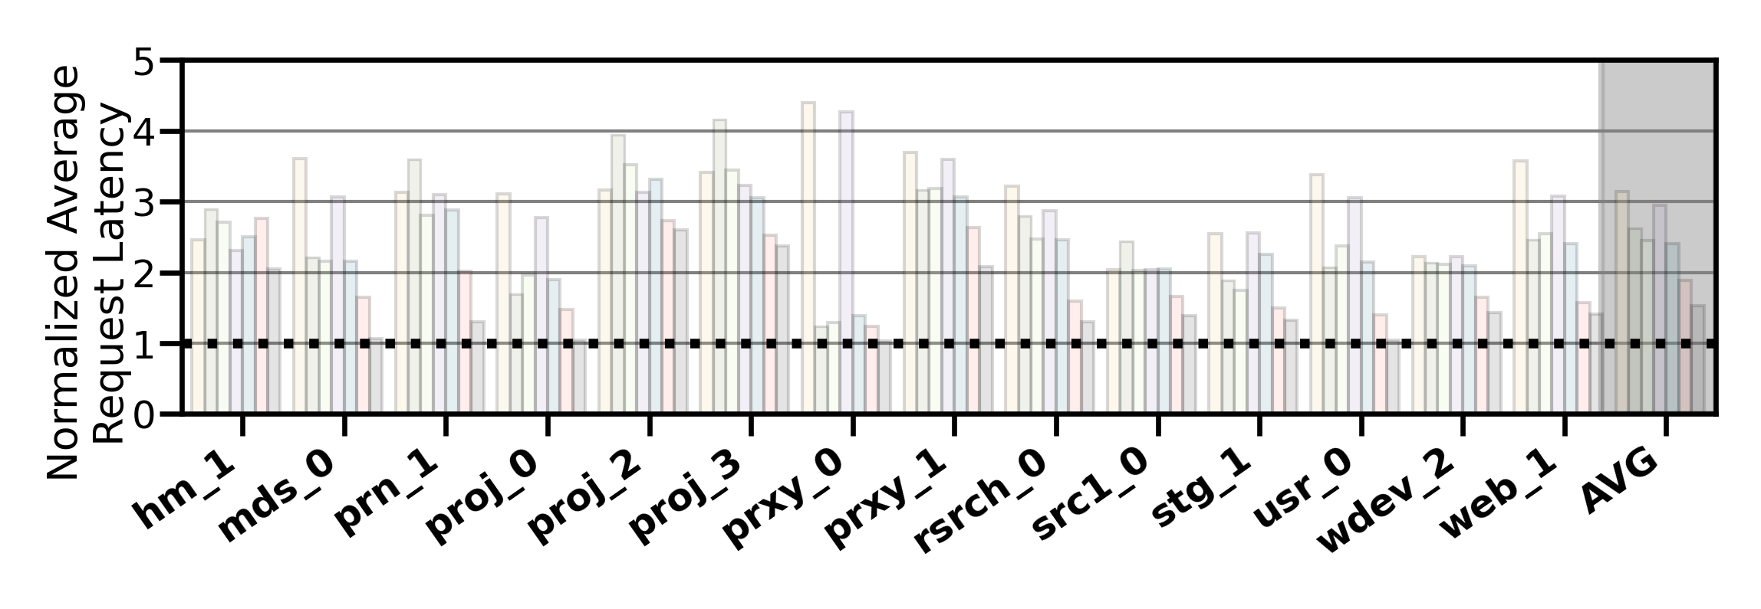
Performance Analysis
High-end SSD
Mid-end SSD
Performance-Oriented HSS Configuration
Slow-Only
CDE
HPS
Archivist
RNN-HSS
Sibyl
Oracle
Notes:
Sibyl provides slightly lower performance than other baselines in only two workloads for this configuration.
We observe that such workloads are write-intensive and have many random requests (in terms of both access pattern and request size).
Therefore, in the paper we show that for such workloads we need to perform frequent retraining

Slide 43
Performance Analysis
High-end SSD
Mid-end SSD
Performance-Oriented HSS Configuration
Slow-Only
CDE
HPS
Archivist
RNN-HSS
Sibyl
Oracle
Sibyl achieves 80% of the performance
of an oracle policy that has
complete knowledge of future access patterns
Notes:
on average Sibyl achieves 80% performance of an oracle policy that has complete knowledge of
future access patterns

Slide 44
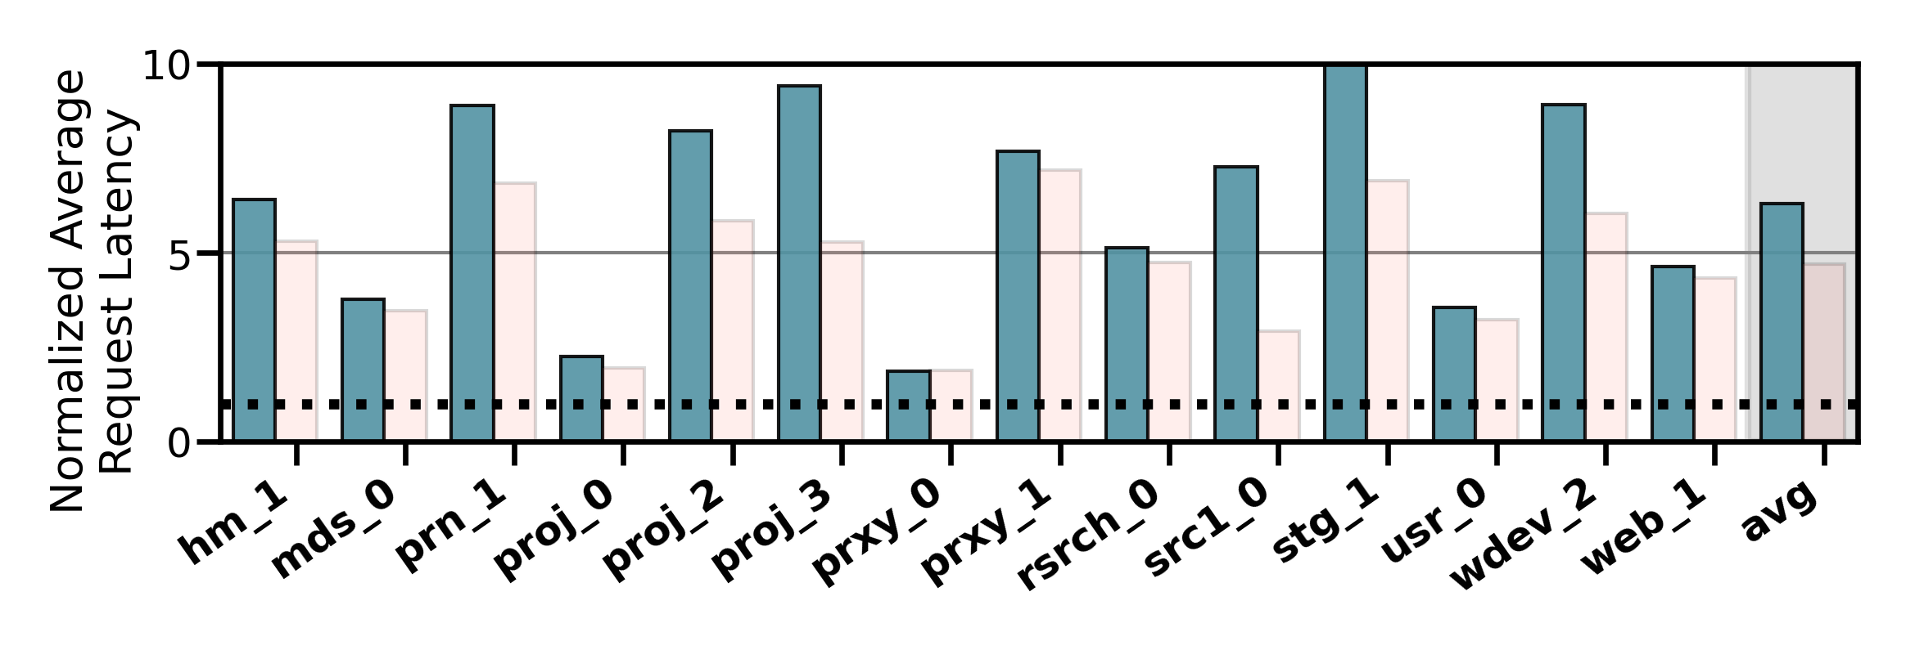
Performance on Tri-HSS
High-end SSD
Mid-end SSD
Low-end HDD
Extending Sibyl for more devices:
Extending Sibyl for more devices:
Add a new action
Add the remaining capacity of the new device as a state feature
Heuristic_{Tri-hybrid}
Sibyl_{Tri-hybrid}
Notes:
We also evaluate the EXTENSIBILITY of sibyl to more devices
To extend sibyl for more storage devices we have to only:
1. Add a new action in sibyl’s action space
2. Add the remaining capacity of the new device as a state feature
and sibyl automatically figures out the best policy
Here we show the performanc results for a state of the art heuristic based policy. This heuristic policy is an extended version of CDE policy which requires significant implementation effort for handling all the dataplacement cases because of the new device like eviction and promotion from the new device and where to send that data, set threshold values etc.

Slide 45
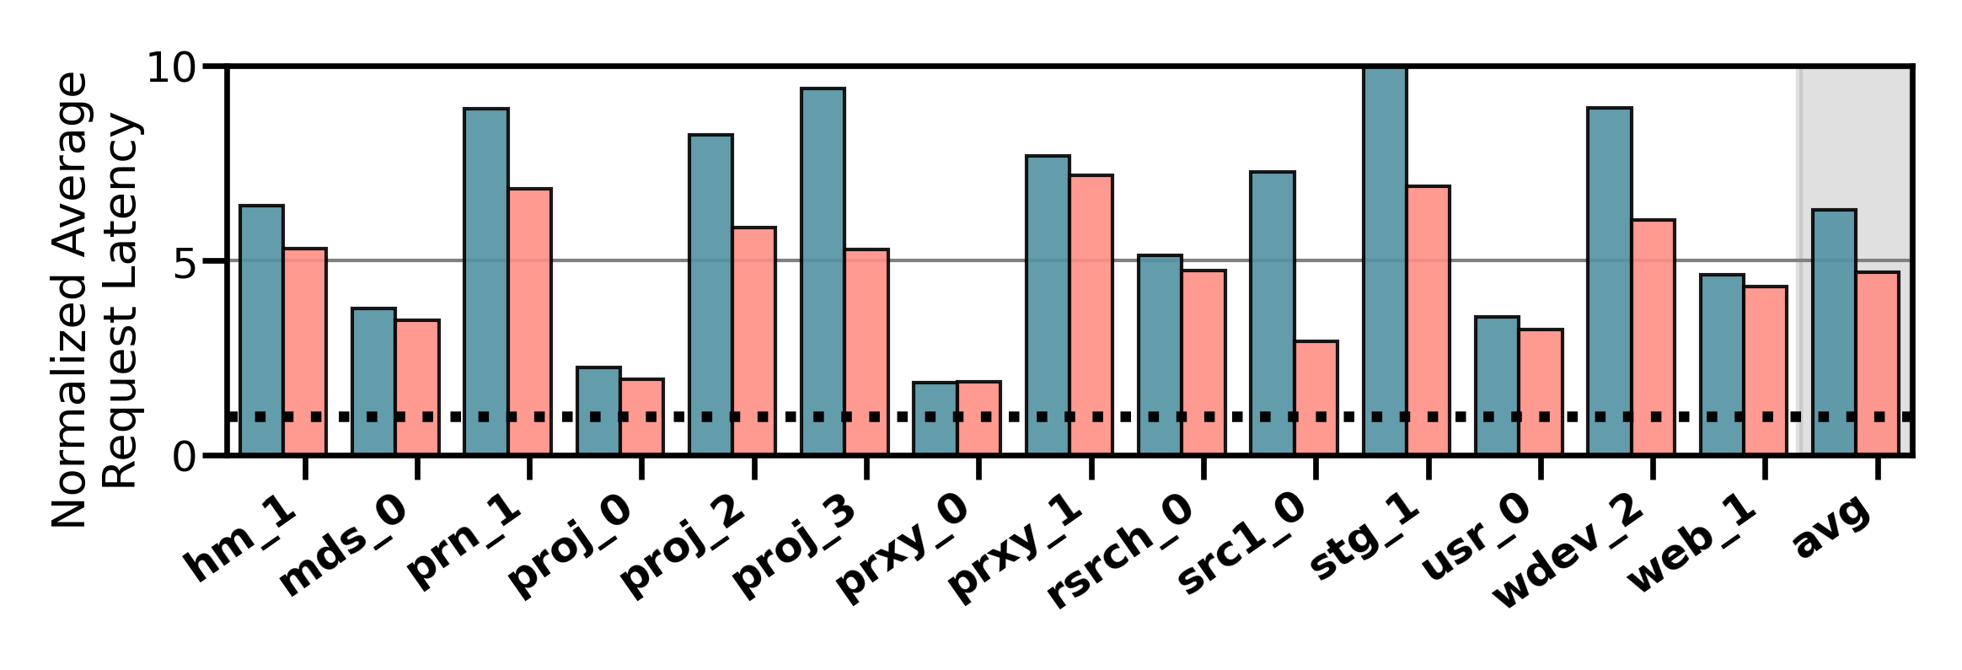
Performance on Tri-HSS
High-end SSD
Mid-end SSD
Low-end HDD
Extending Sibyl for more devices:
Add a new action
Add the remaining capacity of the new device as a state feature
Heuristic_{Tri-hybrid}
Sibyl_{Tri-hybrid}
Notes:
and compare to sibyl for trihybrid system

Slide 46
Performance on Tri-HSS
High-end SSD
Mid-end SSD
Low-end HDD
Extending Sibyl for more devices:
Add a new action
Add the remaining capacity of the new device as a state feature
Sibyl outperforms the state-of-the-art
data placement policy by
48.2% in a real tri-hybrid system
Heuristic_{Tri-hybrid}
Sibyl_{Tri-hybrid}
Sibyl reduces the system architect's burden
by providing ease of extensibility
Notes:
Sibyl outperforms the state-of-the-art-policy policy by upto 48.2%
[click]
We conclude that Sibyl provides ease of extensibility to new storage system configurations, which reduces the system architect’s burden in designing sophisticated data placement mechanisms.

Slide 47

Sibyl’s Overhead
124.4 KiB of total storage cost
Experience buffer, inference and training network
40-bit metadata overhead per page for state features
Inference latency of ~10ns
Training latency of ~2us
Small area overhead
Small inference overhead
Satisfies prediction latency
Notes:
All of Sybil performance benefits comes at a modest cost of 124.4KB storage cost to implement experience buffer, inference and training network
[CLICK] and 40-bit metadata overhead per page
[CLICK] We have inference latency of 10nanos, which are orders of magnitude smaller than the I/O read latency of a even a high end SSD (around 3micro seconds for Samsung ZNAND SSD)
[CLICK] with training latency of 2mico sec
So sibyl provides:
[CLICK]small area and
[CLICK]inference overhead [CLICK] which satisfied the prediction latency for making a data placement decision

Slide 48
More in the Paper (1/2)
Throughput (IOPS) evaluation
Sibyl provides high IOPS compared to baseline policies because it indirectly captures throughput (size/latency)
Evaluation on unseen workloads
Sibyl can effectively adapt its policy to highly dynamic workloads
Evaluation on mixed workloads
Sibyl provides equally-high performance benefits as in single workloads
Notes:
We have many more exciting results in the paper including throughput comparison, evaluation on unseen workloads and mixed workloads

Slide 49
More in the Paper (2/2)
Evaluation on different features
Sibyl autonomously decides which features are important to maximize the performance
Evaluation with different hyperparameter values
Sensitivity to fast storage capacity
Sibyl provides scalability by dynamically adapting its policy to available storage size
Explainability analysis of Sybil's decision making
Explain Sibyl’s actions for different workload characteristics and device configurations
Notes:
And many more.
For more details we encourage you to read our paper

Slide 50
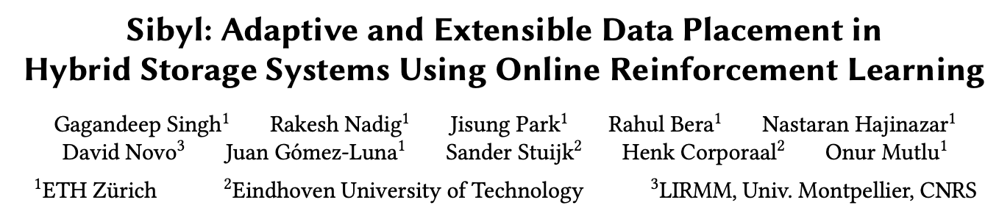
More in the Paper (2/2)
https://arxiv.org/pdf/2205.07394.pdf
https://github.com/CMU-SAFARI/Sibyl

Slide 51
Talk Outline
Key Shortcomings of Prior Data Placement Techniques
Formulating Data Placement as Reinforcement Learning
Sybil: Overview
Evaluation of Sybil and Key Results
Conclusion
Notes:
Now I will conclude my talk

Slide 52
Conclusion
We introduced Sibyl, the first reinforcement learning-based data placement technique in hybrid storage systems that provides
Adaptivity
Easily extensibility
Ease of design and implementation
We evaluated Sibyl on real systems using many different workloads
Sibyl improves performance by 21.6% compared to the best prior data placement policy in a dual-HSS configuration
In a tri-HSS configuration, Sibyl outperforms the state-of-the-art-data placement policy by 48.2%
Sibyl achieves 80% of the performance of an oracle policy with a storage overhead of only 124.4 KiB
https://github.com/CMU-SAFARI/Sibyl
Notes:
We introduced Sibyl, the first reinforcement learning-based data placement in HSS that provides
Adaptivity
Easily extensibility
Ease of design and implementation
We evaluated Sibyl on real systems using many different workloads
Sibyl improves performance by 21.6% compared to the best previous data placement technique in dual-HSS configuration
In a tri-HSS configuration, Sibyl outperforms the state-of-the-art-policy policy by 48.2%
Sibyl achieves 80% performance of an oracle policy with storage overhead of only 124.4 KiB

Slide 53
Sibyl: Adaptive and Extensible Data Placement in Hybrid Storage Systems
Using Online Reinforcement Learning
Gagandeep Singh, Rakesh Nadig, Jisung Park,
Rahul Bera, Nastaran Hajinazar, David Novo,
Juan Gómez Luna, Sander Stuijk, Henk Corporaal,
Onur Mutlu
53
Notes:
Thank you. I will be happy to take any questions

Slide 54
BACKUP
54

Slide 55
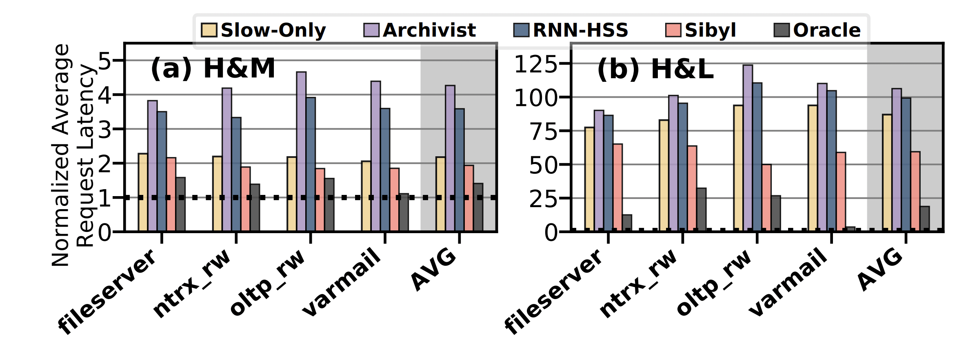
Performance on Unseen Workloads
H&M (H&L) HSS configuration, Sibyl outperforms RNN-HSS and Archivist by 46.1% (54.6%) and 8.5% (44.1%), respectively

Slide 56
Performance Analysis
Performance-Oriented HSS Configuration
Slow-Only
CDE
HPS
Archivist
RNN-HSS
Sibyl
Oracle
Baseline policies are ineffective for many workloads even when compared to Slow-Only
Notes:
For workloads like prn_1, proj_2, etch baseline policies are ineffeciteve even when compared to slow only policy does places everything in the slow storage

Slide 57
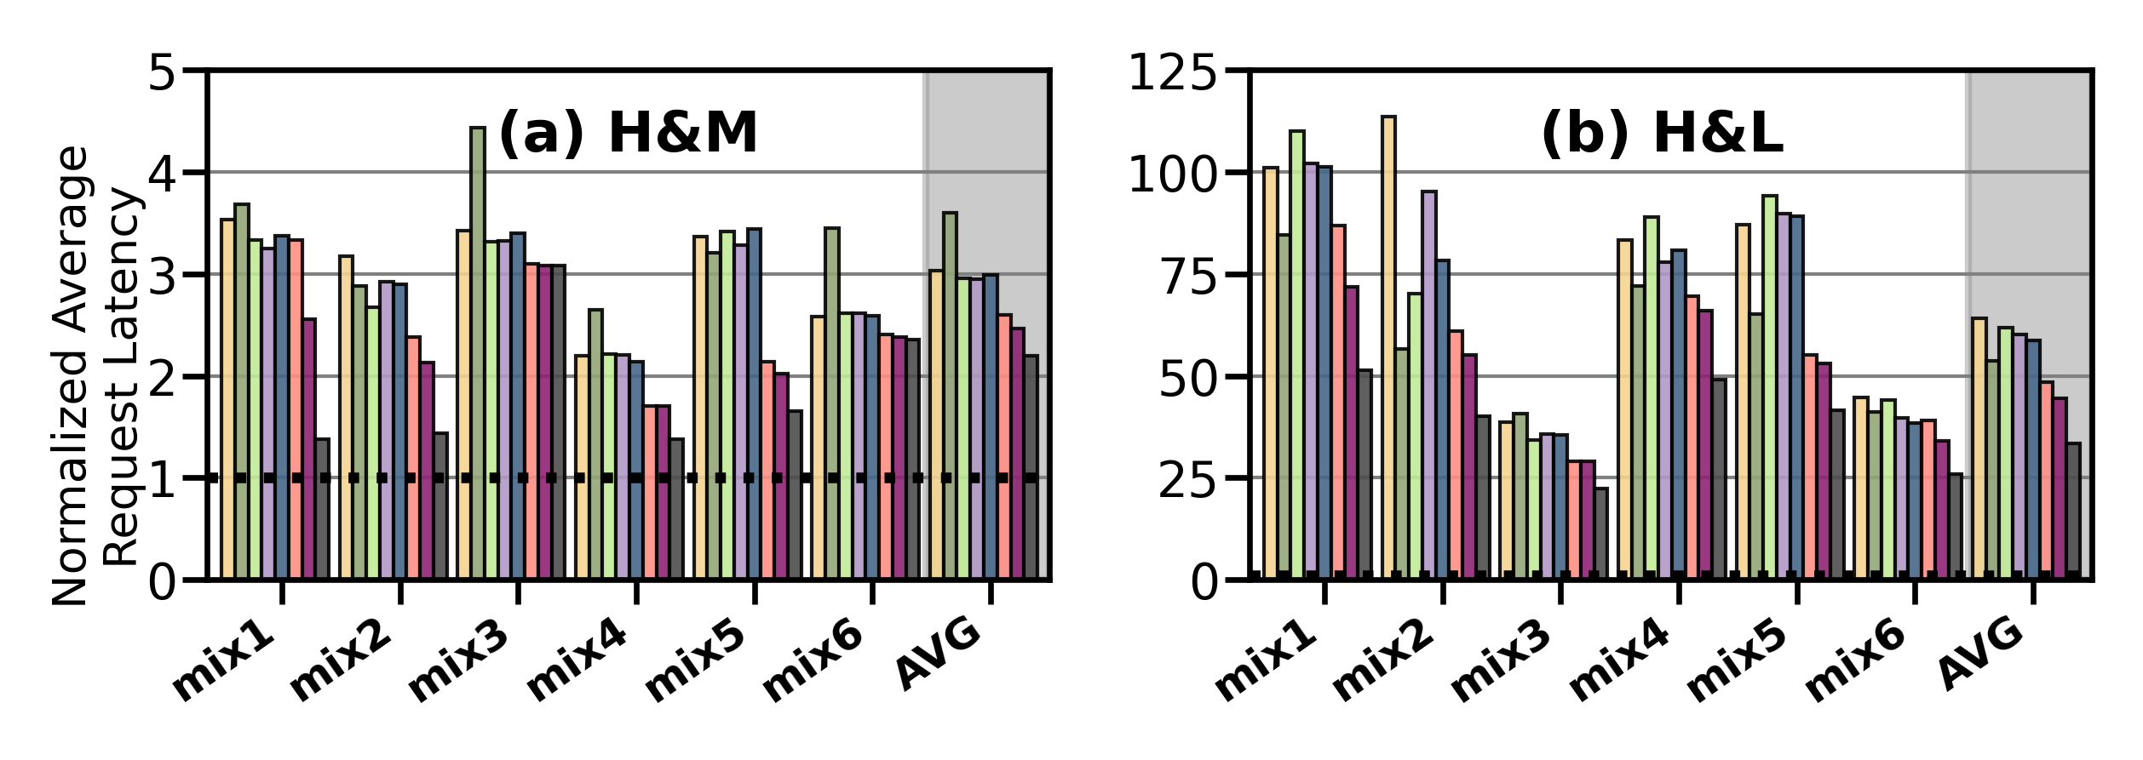
Performance on Mixed Workloads
Slow-Only
CDE
HPS
Archivist
RNN-HSS
Sibyl_{Def}
Sibyl_{Opt}
Oracle
Performance-Oriented
Cost-Oriented
Notes:
We evaluate mixing two or more workloads at the same time while randomly varying their relative start times.
Such a scenario
leads to unpredictable execution where requests arrive at dif- ferent, unpredictable timesteps,
mimics distributed workloads,
(3) further tests the ability of Sibyl to dynamically adapt its decision-making policy.
shows average request latency for mixed workloads in two different storage configuration.[click] We use two different settings for Sibyl: (a) Sibyl𝐷𝑒 𝑓 , where we use our default hyper-parameters and (b) Sibyl𝑂𝑝𝑡, where we optimize the hyper-parameters for these mixed workloads

Slide 58
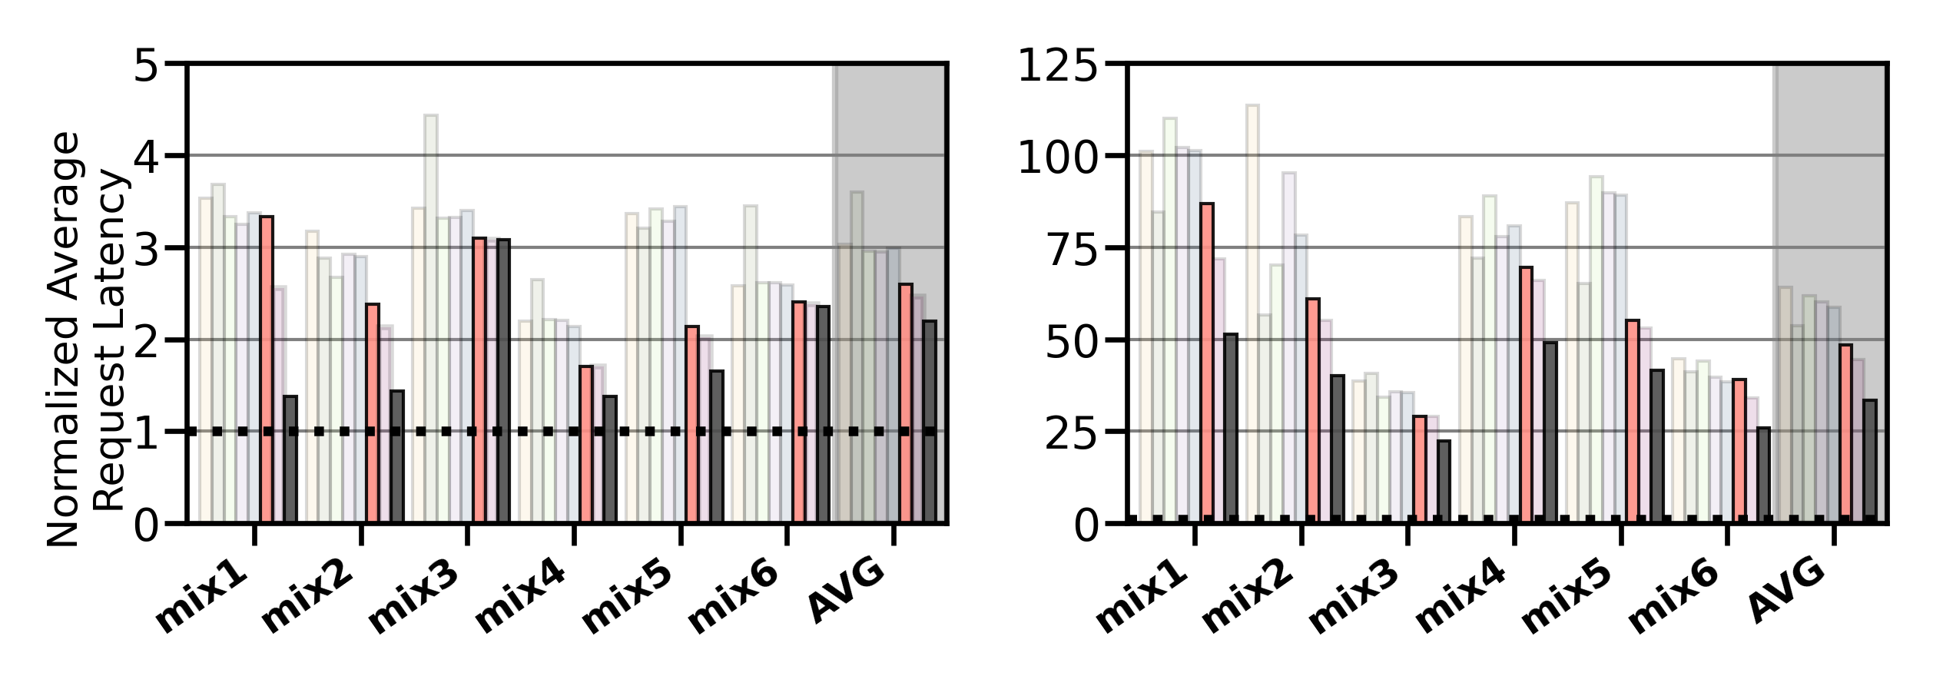
Performance on Mixed Workloads
Slow-Only
CDE
HPS
Archivist
RNN-HSS
Sibyl_{Def}
Sibyl_{Opt}
Oracle
Performance-Oriented
Cost-Oriented
Sibyl_{Def} outperforms baseline data placement techniques by up to 27.9%
Notes:
Sibyl𝐷𝑒 𝑓 provides upto 27.9% higher performance than baseline policies

Slide 59
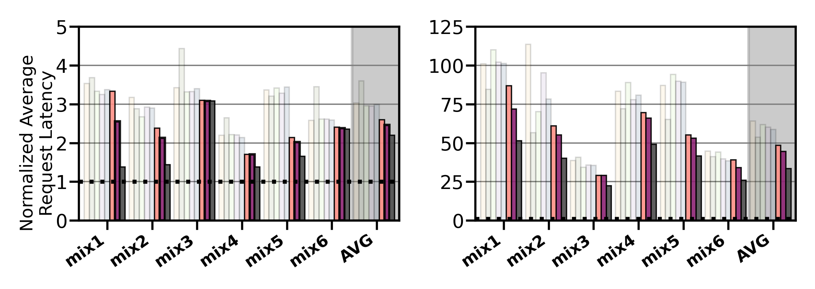
Performance on Mixed Workloads
Slow-Only
CDE
HPS
Archivist
RNN-HSS
Sibyl_{Def}
Sibyl_{Opt}
Oracle
Performance-Oriented
Cost-Oriented
Sibyl_{Def} outperforms baseline data placement techniques by up to 27.9%
Sibyl_{Opt} provides 7.2% higher average performance than Sibyl_{Def}
Notes:
With optimized hyper-parameters, Sibyl𝑂𝑝𝑡 provides 5.2% (9.3%) higher average performance for H&M (H&L) HSS configuration than Sibyl𝐷𝑒 𝑓 .
We conclude that Sibyl can effectively adapt its data placement policy online to highly dynamic workloads.

Slide 60
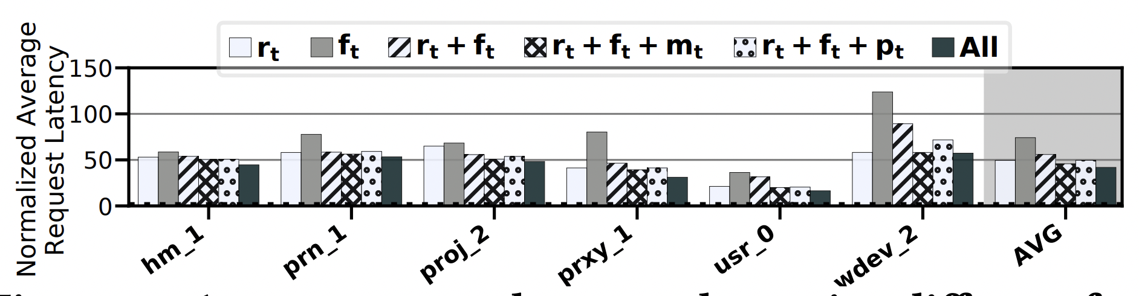
Performance With Different Features
Sibyl autonomously decides which features are important to maximize the performance of the running workload

Slide 61
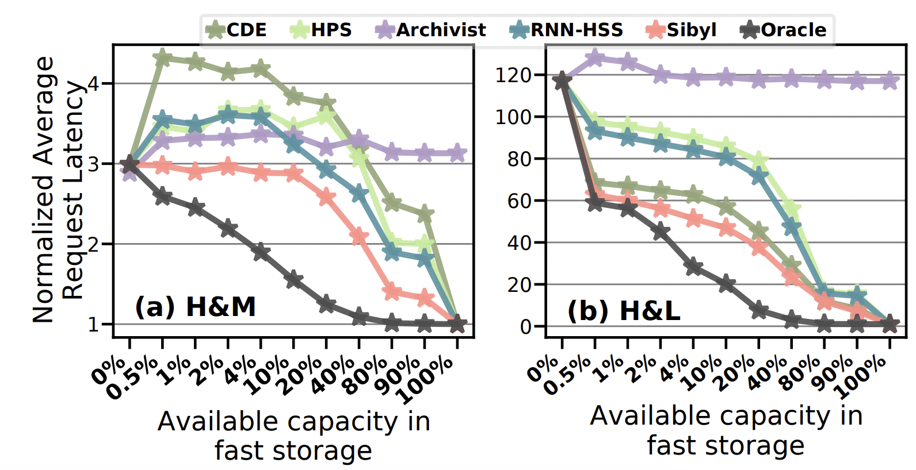
Sensitivity to Fast Storage Capacity

Slide 62
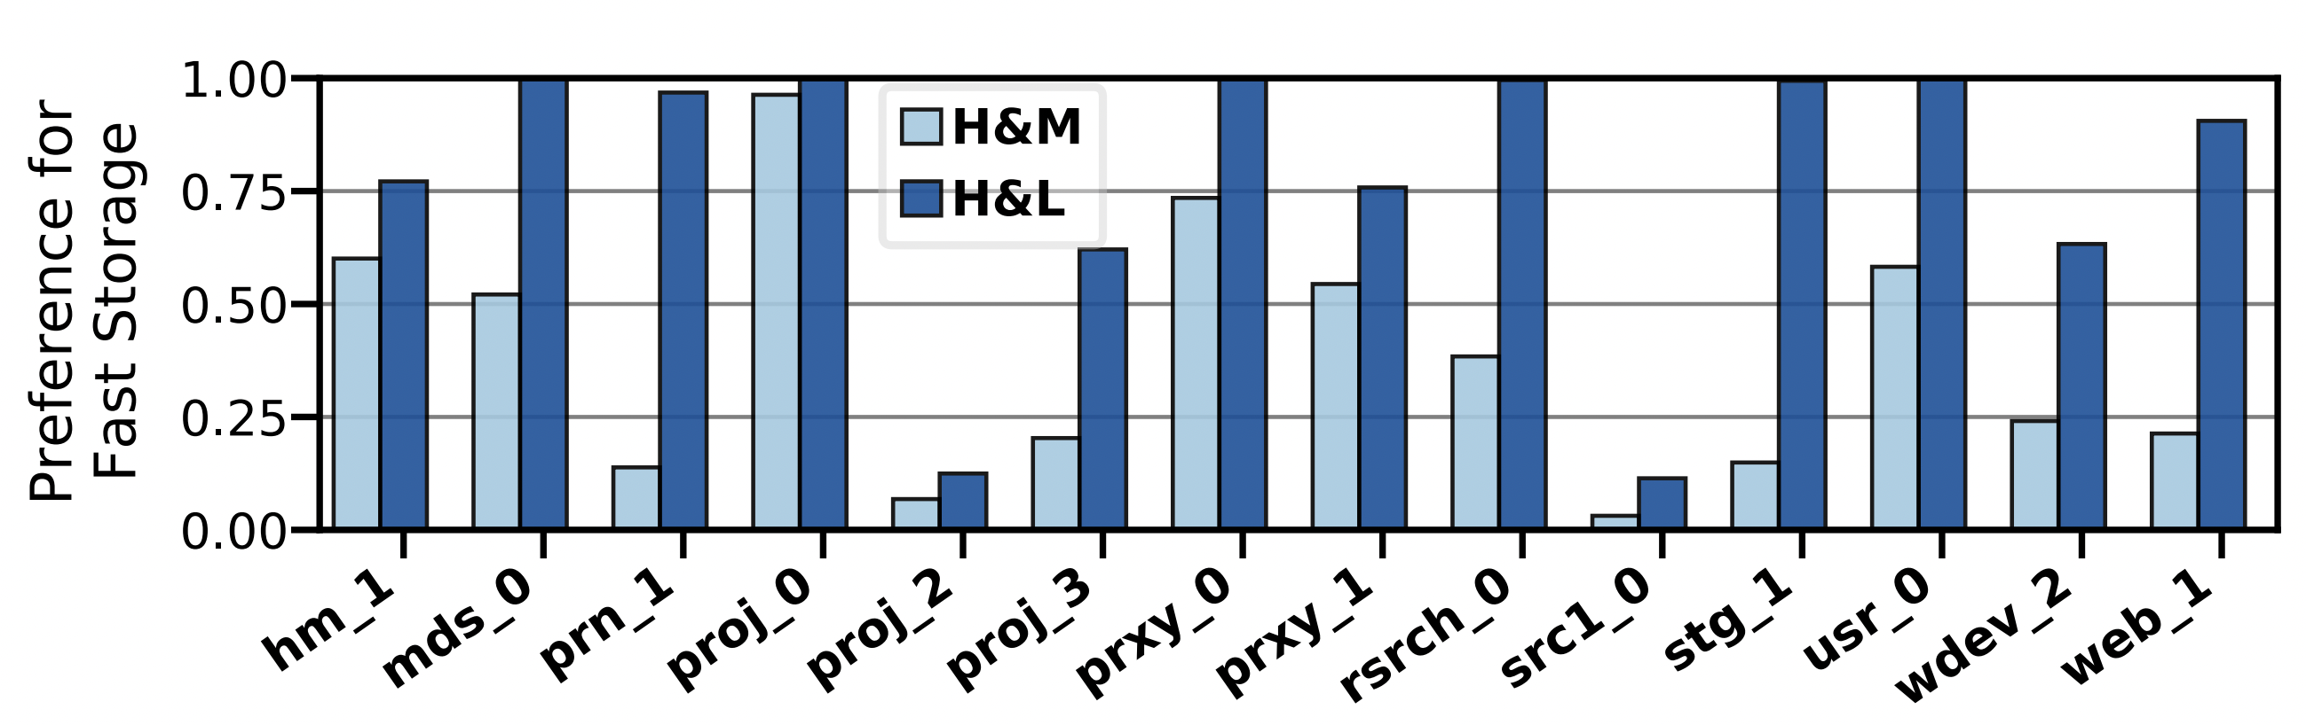
Explainability Analysis

Slide 63
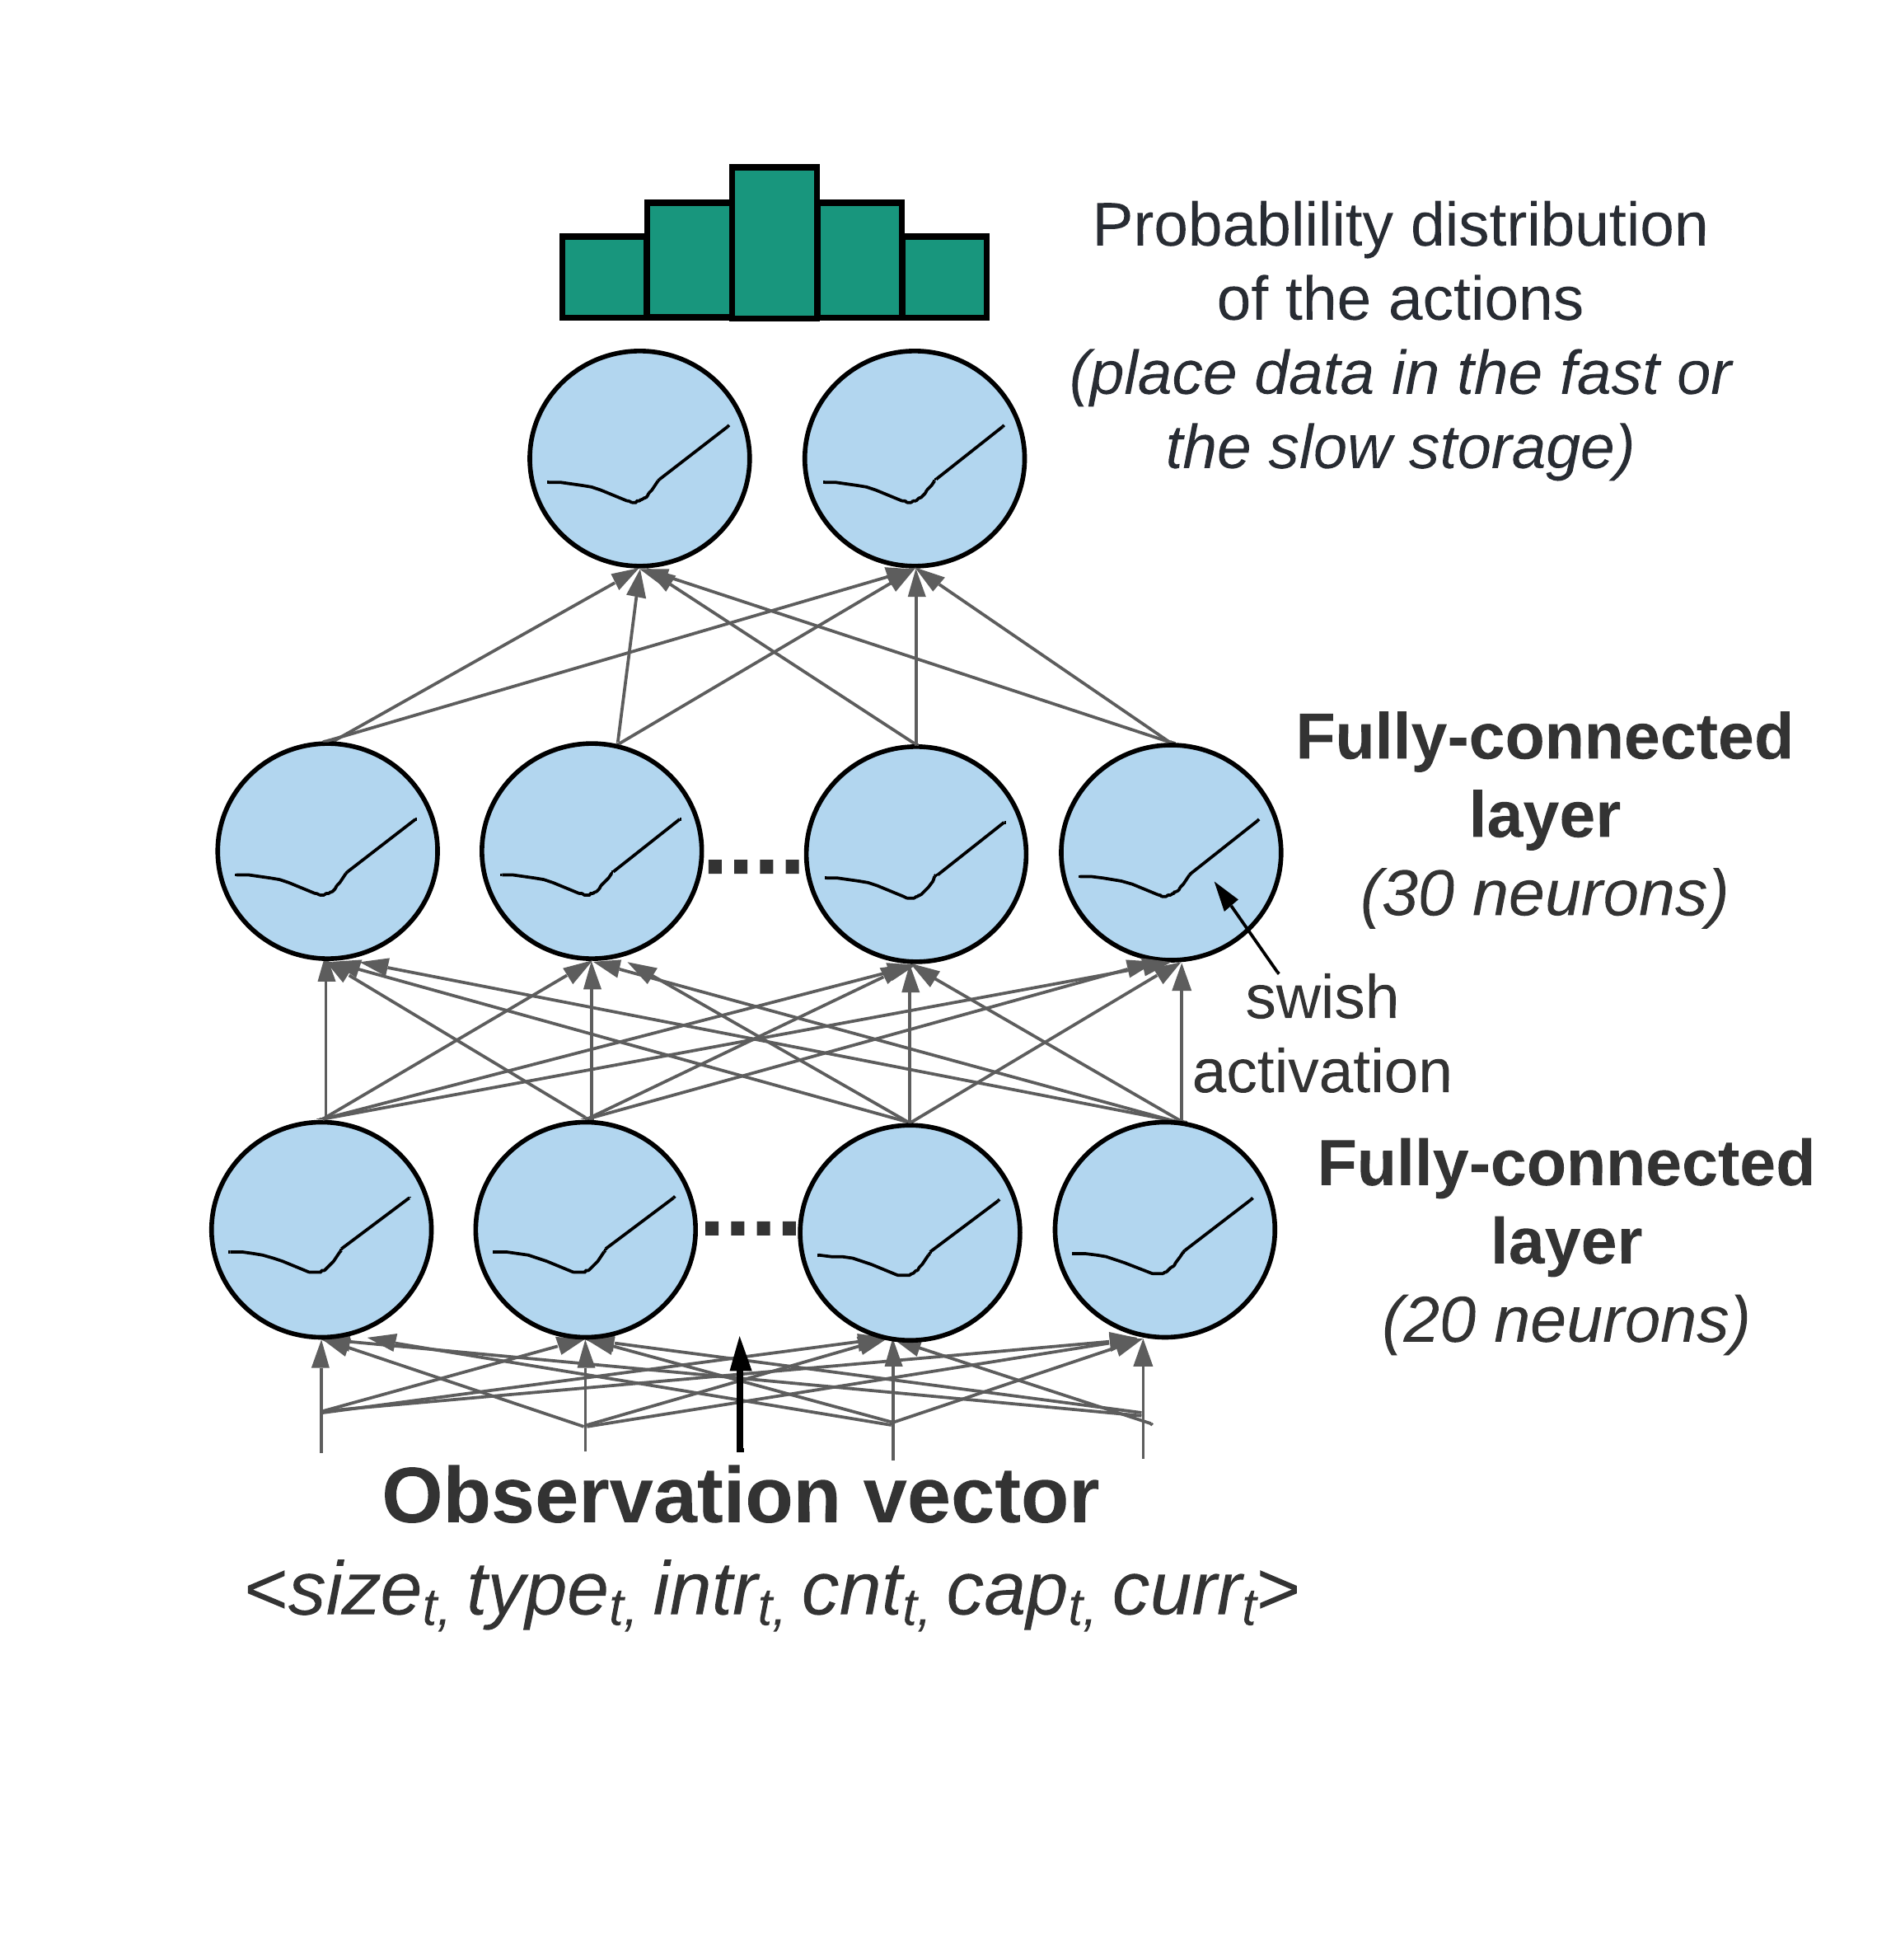
Training and Inference Network
Training and inference network allow parallel execution
Observation vector as the input
Produces probability distribution of Q-values
Notes:
A deep neural network can be prohibitive due to the long time it requires for training and convergence, preventing Sibyl to adapt to new state-action pairs in a timely manner.
Based on experiments, we find that a simple feed-forward network [135] with only two hidden layers [136] provides good performance for Sibyl’s data placement task.
The network takes the observation vector 𝑂𝑡 as its input and produces a probability distribution of Q-values as its output

Slide 64
Sibyl: Adaptive and Extensible Data Placement in Hybrid Storage Systems
Using Online Reinforcement Learning
Gagandeep Singh, Rakesh Nadig, Jisung Park,
Rahul Bera, Nastaran Hajinazar, David Novo,
Juan Gómez Luna, Sander Stuijk, Henk Corporaal,
Onur Mutlu
49th ISCA 2022, New York, USA
Notes:
Hi First of all. Thank you very much for staying until this long. I am Gagandeep Singh. I am a postdoctoral researcher at safari research group at ETH Zurich Today, I’m going to present our work “…”

